Slide 1

Getting Schools on Board for Inclusion: Setting the International Agenda?
Richard Rieser
World of Inclusion Ltd
www.worldofinclusion.com

Slide 2


By Richard Rieser and Micheline Mason
Published March 1990 by ILEA,
2nd Edition published by DEE with loan funding from Comic Relief 2002

Slide 3
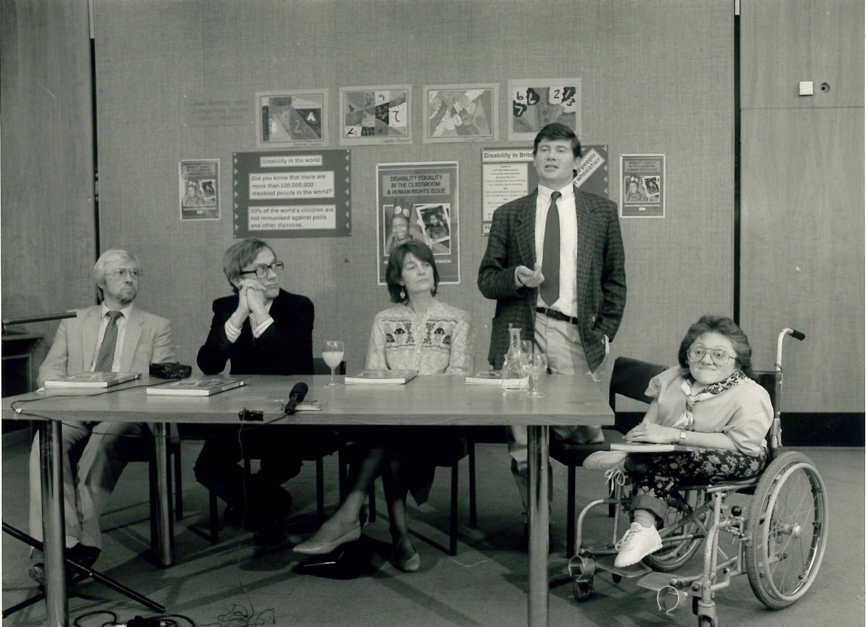
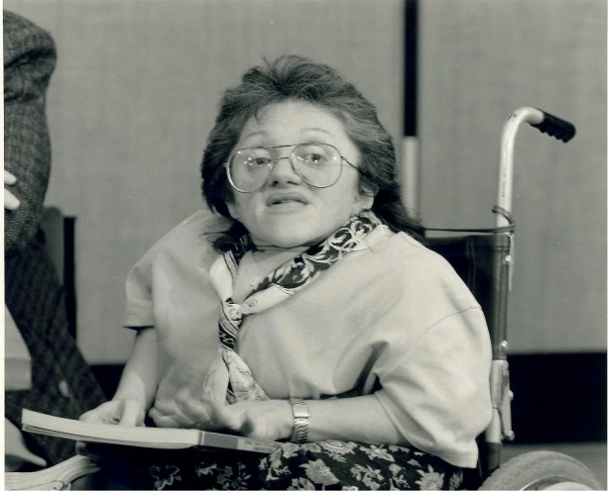
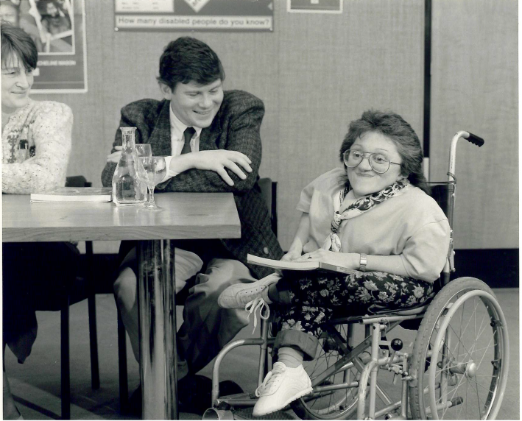

Neil Fletcher, Leader, David Mallen, CEO, Elizabeth Monck, Schools Sub Committee, ILEA,
Richard Rieser and Micheline Mason at Launch, County Hall, Friday 16th March 1990

Slide 4

Training in DET & inclusion of Teachers & other staff-over 120,000
Training Disabled Equality Trainers to Deliver courses-160 trainers currently.
Set up 1992
Empowerment training of young disabled people-Free Up Your Life
Support the development of such thinking amongst disabled people and their allies in other countries.
Resource Development- For training, to use in classrooms & to educate about disability equality & inclusion - Disabling Imagery; Real People Real Lives; All Equal All Different, Altogether Better; Disability Equality in the Classroom; Course Books
Act as change consultants to end segregation & develop inclusive practice.

Slide 5
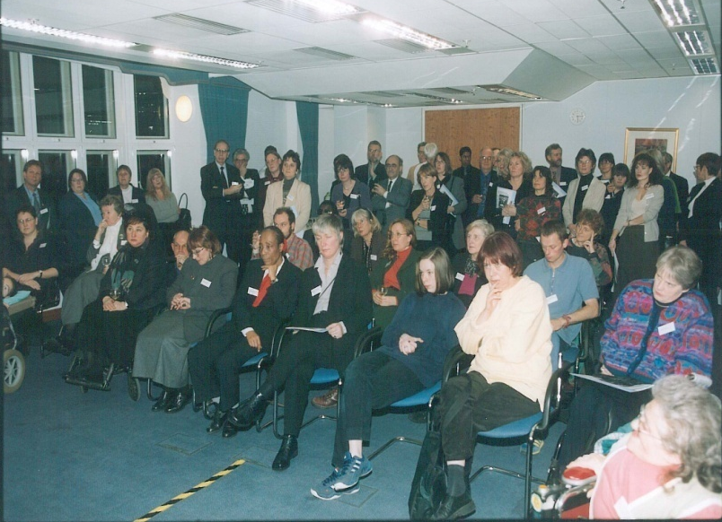
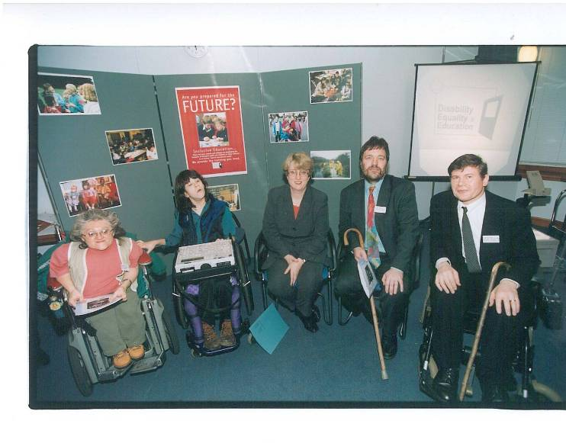

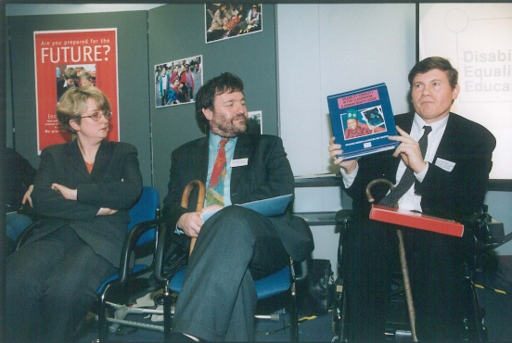
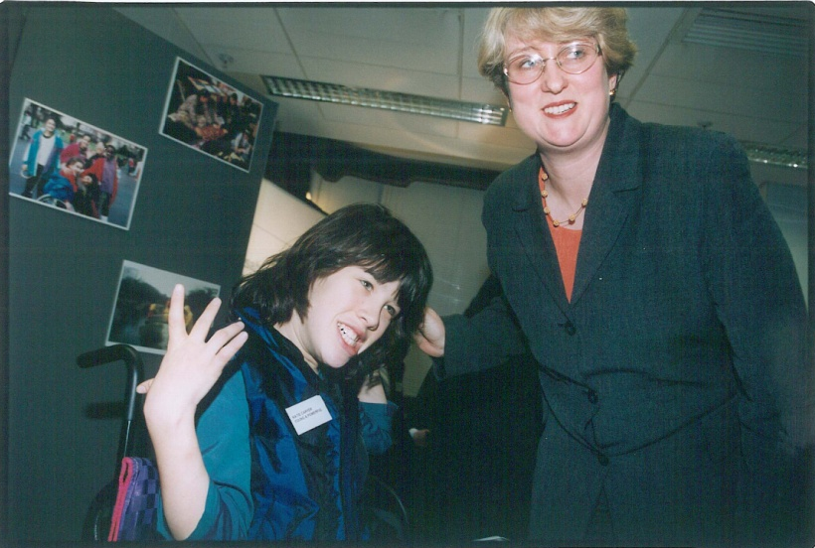
DEE Relaunch af DfES 1999

Slide 6



DEE First Course Book, 2001
2002 Second Course Book
DEE With CDC 2002

Slide 7
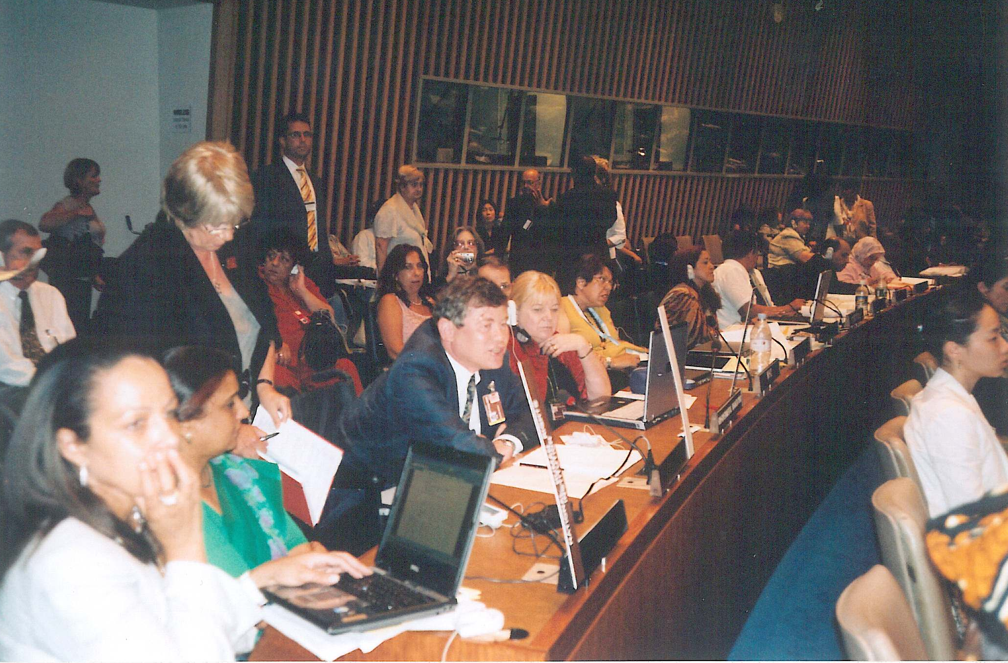
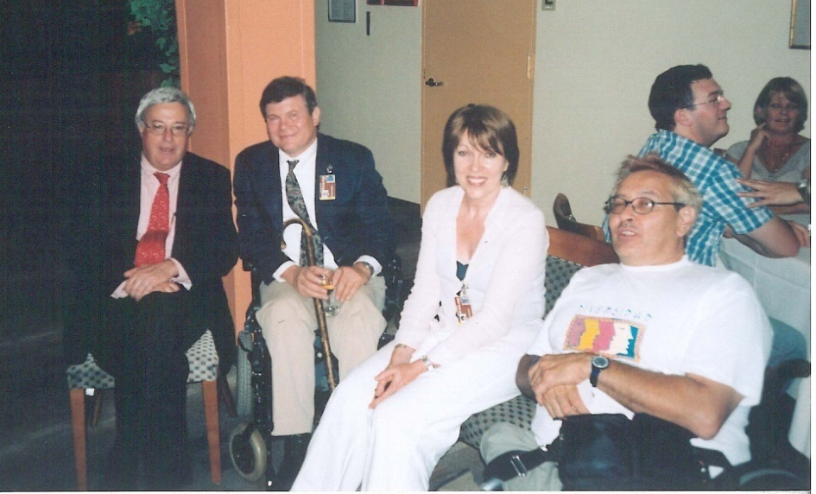
Campaigning and Drafting Article 24 UNCRPDat UN New York 2005/2006
Speaking in debate on Article 24
Susie Burrows & Richard with Don McKay Chair Ad Hoc at UN

Slide 8
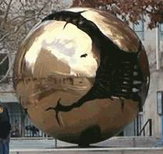

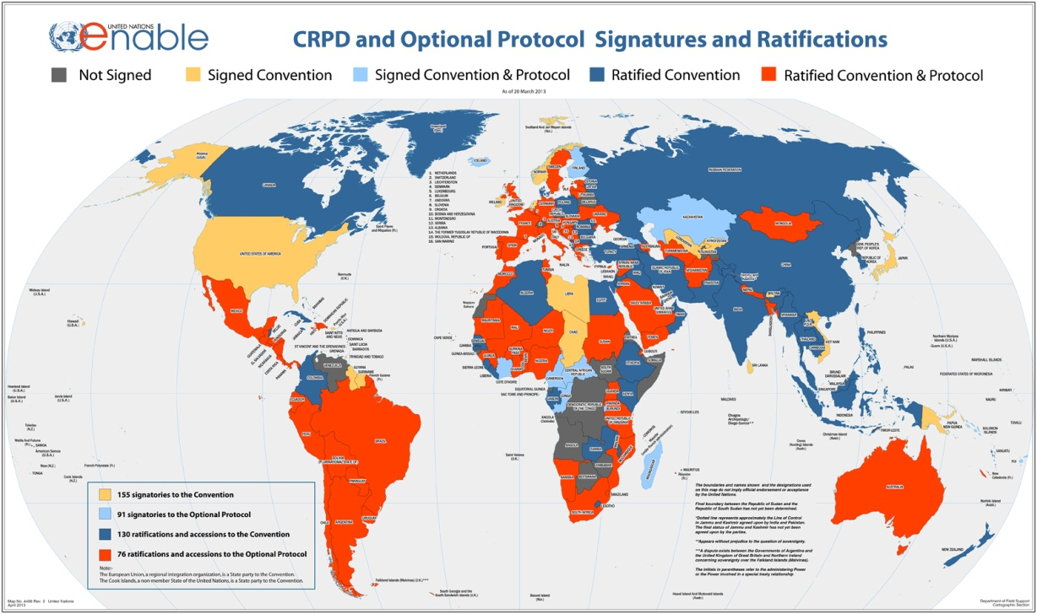

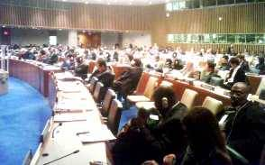
UNITED NATIONS CONVENTION ON THE RIGHTS OF PEOPLE WITH DISABILITIES DEC. 2006:A NEW PARADIGM CENTERED ON THE PERSON WITH DISABILITY
From Medical Model of Disability → Problem in the Person.
Cure, Fix or Separate
To Social Model of Disability based on Human Rights approach- Problem with Society that needs to be changed.
Attitudes
Organisation
Environment
To
159 signatories to the Convention
152 ratifications of the Convention
Optional Protocol
92 signatories
85 ratifications

Slide 9

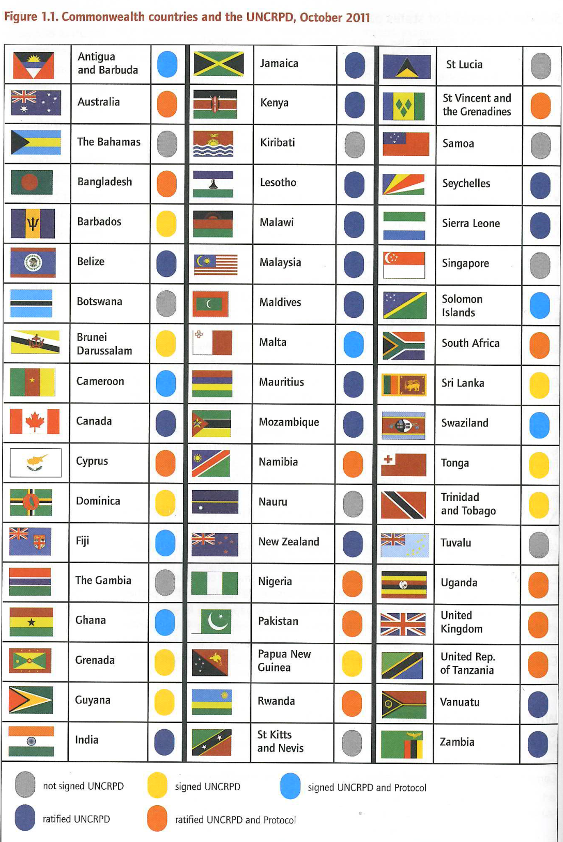

R. Rieser 2012

Slide 10


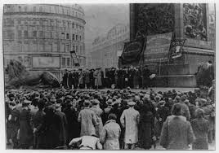


Themes of UK Disability History Month
2010 Founded- Education and the struggle for Inclusion
2011 Disabled Peoples Struggle for Rights
2012 Changing Lives, Changing Times.
No to Hate Crime
2013 Celebrating Our Struggle for Independent Living: No return to the Institution and Isolation
2014 War and Impairment: The Social Consequences of Disablism
2015 Portrayal in the Media and and Moving Image

Slide 11
UNICEF Preparing Teachers for Children with Disabilities
Problem of single track inclusion Education for All
Need for Twin Track Approach
A General Inclusion
B Impairment Specific Adjustments
Lack of commitment and political will go to scale
Involvement of Disabled Peoples Organisations

Slide 13
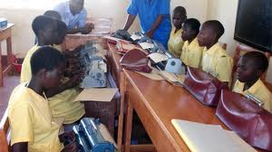
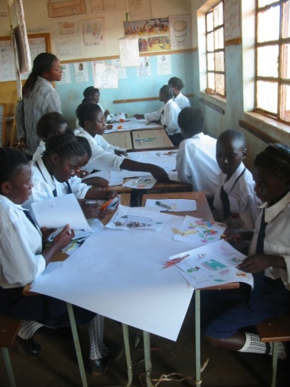
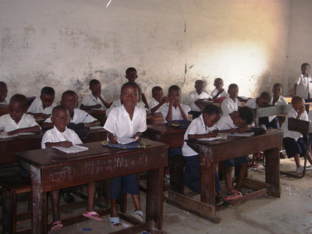
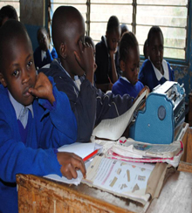
 | A1 | A2 | B1 | B2 | C1 | C2 | D1 | D2 | E1 | E2 | F1 | F2 | G1 | G2
Aweil | 20 | 2 | 1 | 20 | 17 | 5 | 1 | 22 | 4 | 18 | 21 | 0 | 0 | 20
Yei | 44 | 9 | 21 | 25 | 35 | 18 | 12 | 37 | 4 | 51 | 53 | 3 | 4 | 48
Juba | 13 | 1 | 7 | 7 | 10 | 5 | 2 | 12 | 0 | 14 | 14 | 0 | 3 | 11
Morobo | 19 | 1 | 2 | 18 | 17 | 2 | 1 | 19 | 0 | 20 | 20 | 1 | 0 | 19
Mundri East | 15 | 2 | 1 | 16 | 17 | 0 | 1 | 16 | 1 | 16 | 17 | 0 | 0 | 17
Mundri West | 10 | 2 | 3 | 11 | 10 | 4 | 4 | 10 | 0 | 14 | 14 | 0 | 0 | 14
Rumbek | 16 | 1 | 4 | 13 | 14 | 4 | 1 | 16 | 1 | 16 | 15 | 2 | 3 | 14
Torit | 19 | 1 | 6 | 12 | 11 | 8 | 6 | 14 | 1 | 19 | 17 | 2 | 6 | 14
Wau | 13 | 10 | 7 | 15 | 12 | 11 | 6 | 16 | 1 | 21 | 20 | 2 | 2 | 21
IDEAL CHOICE | x |  |  | x | x |  |  | x |  | x | x |  |  | x
B1
Blind students taught together away from their non-disabled peers learning to use Perkins Braille machine
A1 | A2
Classroom that promotes child centred learning through group work, peer support, cooperative learning. | Traditional classroom where the teacher gives the instructions, a one size fits all approach.
B2
Blind students included with peers using Braille Machine.

Slide 14
Key Barriers to Inclusion
REM Reform Education Movement-privatisation
Competition versus collaboration
Lack of Adequate training for teachers
Lack of adequate disaggregated data
Lack of involvement Disabled People
Lack of Youth Involvement
Lack of genuine parental control
Lack of clarity Article 24

Slide 15



