Slide 1

Preparing teachers to include children with disabilities: Internationally what works well
Richard Rieser
World of Inclusion UNICEF Consultant
E-mail rlrieser@gmail.com
Website www.worldofinclusion.com

Slide 2

Shifting the Focus at UN
“Recognizing that disability is an evolving concept and that disability results from the interaction of persons with impairments and attitudinal and environmental barriers that hinders their full and effective participation in society on an equal basis with others.”
Paradigm Shift -Persons with disabilities are not viewed as "objects" of charity, medical treatment and social protection; rather as "subjects" with rights, who are capable of claiming those rights and making decisions for their lives based on their free and informed consent as well as being active members of society.
http://www.un.org/disabilities/

Slide 3


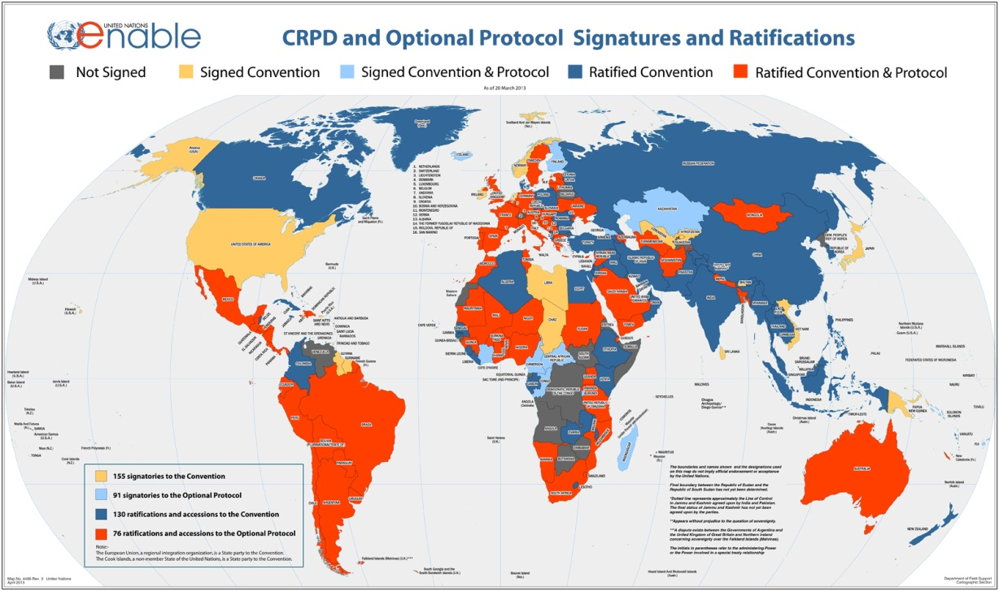

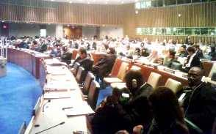
UNITED NATIONS CONVENTION ON THE RIGHTS OF PEOPLE WITH DISABILITIES DEC. 2006:A NEW PARADIGM CENTERED ON THE PERSON WITH DISABILITY
From Medical Model of Disability → Problem in the Person.
Cure, Fix or Separate
To Social Model of Disability based on Human Rights approach- Problem with Society that needs to be changed.
Attitudes
Organisation
Environment
To
158 signatories to the Convention
138 ratifications of the Convention
Optional Protocol
92 signatories
78 ratifications

Slide 4
In many parts of the world Traditional Ideas about disability are still dominant
Training participants Southern Africa and South Pacific give many examples of myth, superstition and magic causes to be:-
Demon Possessed
Bewitched/cursed
Tools for begging
Contagious
Shameful
A Burden
Asexual, cure for AIDS
Cannot be educated
Laughable
Because your parents did something wrong
Angry spirits
Broke a taboo
Pregnant woman saw or ate something
Your own fault
Wrong Marriage
Worshipping Animals
Misuse bride price

Slide 5
The dominant view is the
Medical Model.
CHILD DEVELOPMENT TEAM
SPECIALISTS
SOCIAL WORKERS
DOCTORS
SURGEONS
GPs
THE IMPAIRMENT
IS THE PROBLEM
SPECIAL TRANSPORT
SPEECH THERAPISTS
EDUCATIONAL PSYCHOLOGISTS
OCCUPATIONAL THERAPISTS
SPECIAL SCHOOLS
SHELTERED WORKSHOPS
BENEFITS AGENCY
TRAINING CENTRES
DISABLED PEOPLE AS PASSIVE RECEIVERS OF SERVICES AIMED AT CURE OR MANAGEMENT

Slide 6
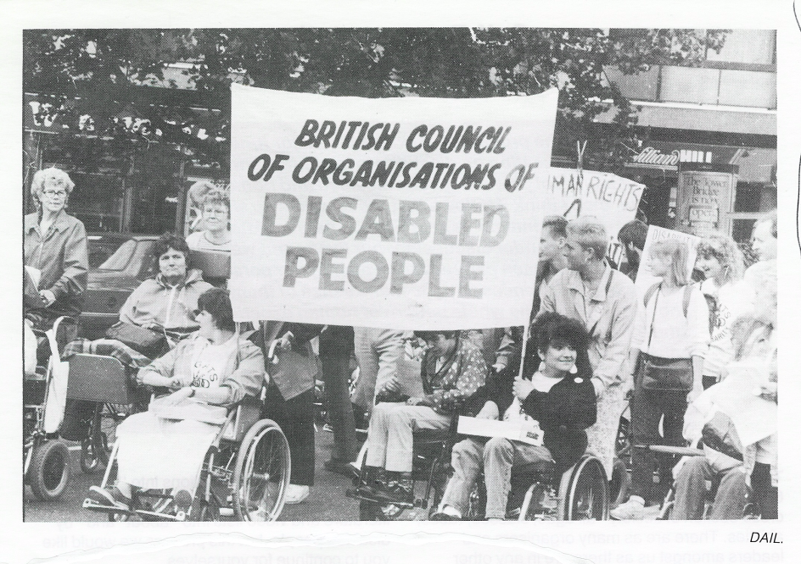
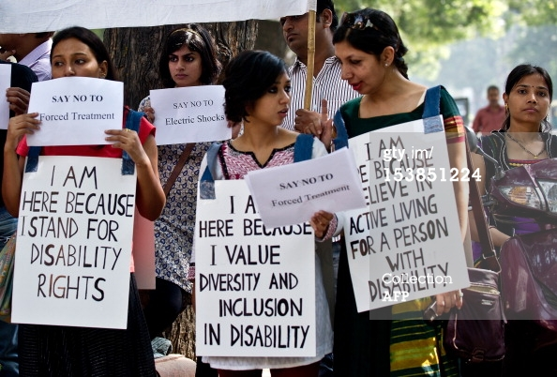
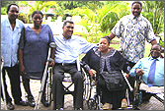
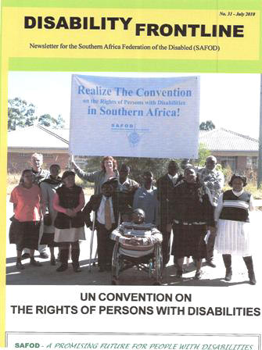
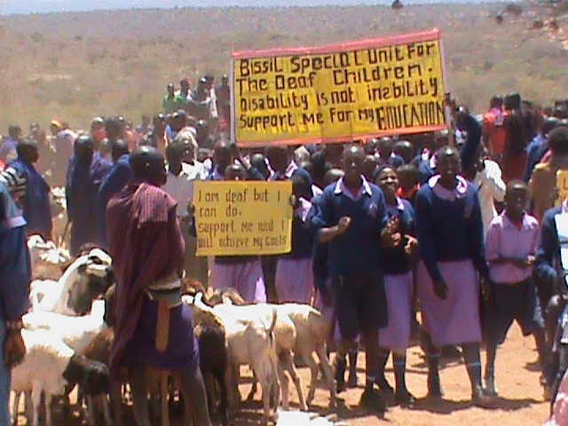
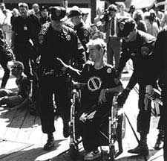
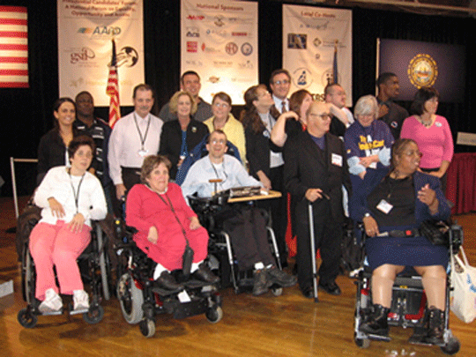
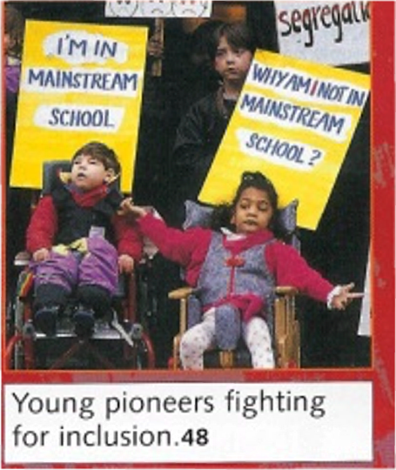
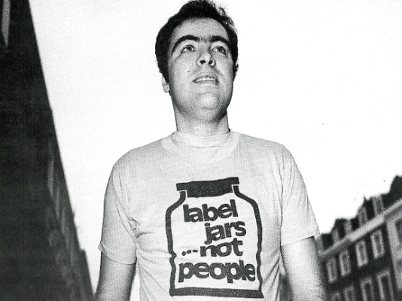
Struggles of Parents and Disabled People for Inclusion
Disabled People & Parents Organise and Fight Back
People First- People with learning Difficulties 1984

Slide 7
The Social Model of disablement focuses on the barriers
LACK OF USEFUL EDUCATION
DISCRIMINATION IN EMPLOYMENT
INACCESSIBLE ENVIRONMENT
SEGREGATED SERVICES
THE STRUCTURES WITHIN
SOCIETY ARE THE PROBLEM
DE-VALUING
POVERTY
‘BELIEF’ IN THE MEDICAL MODEL
PREJUDICE
INACCESIBLE TRANSPORT
INACCESSIBLE INFORMATION
DISABLED PEOPLE AS ACTIVE FIGHTERS FOR EQUALITY
WORKING IN PARTNERSHIP WITH ALLIES.

Slide 8
Types of thinking about disabled people and forms of education.
Thinking/Model | Characteristics | Form of Education
7.81 Traditional | DP a shame on family, guilt, ignorance. DP seen as of no value. | Excluded from education altogether.
7.82 Medical 1 | Focus on what DP cannot do. Attempt to normalize or if cannot make to fit into things as they are keep them separate. | Segregation Institutions/ hospitals Special schools (with ‘expert’ special educators)
7.83 Medical 2 | Person can be supported by minor adjustment and support, to function normally and minimize their impairment. Continuum of provision based on severity and type of impairment. | Integration in mainstream:- a)At same location-in separate class/units b)Socially in some activities e.g. meals, assembly or art. c)In the class with support, but teaching & learning remain the same. What you cannot do determines which form of education you receive.
7.84 Social Model | Barriers Identified-solutions found to minimize them. Barriers of attitude, environment and organization are seen as what disables and are removed to maximize potential of all. DP welcomed . Relations are intentionally built. DP achieve their potential. Person centred approach. | Inclusive education- schools where all are welcomed and staff, parents and pupils value diversity and support is provided so all can be successful academically and socially. This requires reorganizing teaching, learning and assessment. Peer support is encouraged. Focus on what you can do.

Slide 9
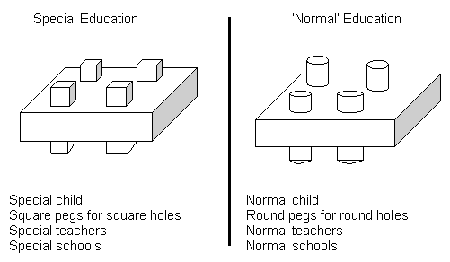
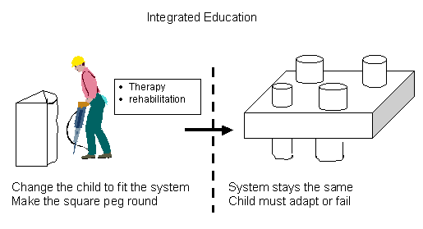
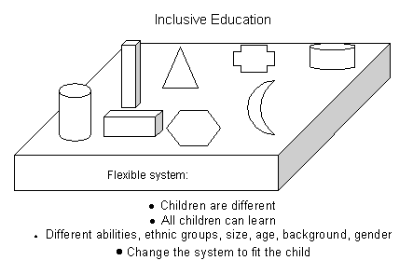
Exclusion
Segregation
?

Slide 10


Slide 12
Putting the Paradigm Shift into Practice in Education
“Special education in developed countries, but also in developing countries, can help create and reiterate negative stereotypes towards students and persons with disabilities.
The removal of children with disabilities from the mainstream education denies students without disabilities access to the experience of disability, which in turn perpetuates ignorance and stigma.
The social model of disability reflected in the CRPD, recognizing the combination of a person’s impairment situated in a discriminating society, requires changing the social system, which includes the education system.

Slide 13
Putting the Paradigm Shift into Practice in Education 2
Special education today reproduces the discriminatory social system by reinforcing the assumption that individuals with specific characteristics do not fit in society and thus places them in separate situations.” IDA 2011
Nothing About Us Without Us
All teachers need Disability Equality Training delivered by trainers with disabilities to challenge negative attitudes and promote social model thinking.

Slide 14
UNCRPD Article 24 Education
Requires all signatories to ensure all disabled children and young people can fully participate in the state education system and that this should be an ‘inclusive education system at all levels’
The development by persons with disabilities of their personality, talents and creativity, as well as their mental and physical abilities, to their fullest potential.
This right is to be delivered within an inclusive primary and secondary education system, from which disabled people should not be excluded.
Reasonable accommodations should be provided for individual requirements and support provided in individualised programmes to facilitate their effective social and academic education.

Slide 15
UNCRPD Article 24 Education -2
Instruction in Braille , Sign language AAC
Employment of disabled teachers
Train professionals and staff who work at all levels of education. Such training shall incorporate disability awareness and the use of appropriate augmentative and alternative modes, means and formats of communication, educational techniques and materials to support persons with disabilities
Article 8 b-Awareness Raising ‘Fostering at all levels of the education system, including in all children from an early age, an attitude of respect for the rights of persons with disabilities’

Slide 16
Inclusive Education -UNESCO
Inclusive Education -UNESCO sees inclusive education as a process of addressing and responding to diversity of needs of all learners through increasing participation in learning, cultures and communities, and reducing exclusion within and from education. It involves changes and modifications in content, approaches, structures and strategies, with a common vision which covers all children of appropriate age range and a conviction that it is the responsibility of the regular system to educate all children. UNESCO 2005

Slide 17
Statistics Education and Children with Disabilities
If 1 Billion disabled people in the world, children with disabilities in the majority world will be 250-300 million. Twice current estimates.
Despite success of Education for All, with 95% enrolled in primary, a larger proportion of those not in school are children with disabilities-40% +
Drop out and failure to complete primary is higher.
Lack of Transition to secondary and higher education - much higher.
Many states only record 2-3% of children as disabled. Recent work through UN Statistics in selected countries puts it at 14%-20%.

Slide 18
Why are so few children with disabilities accessing and completing basic education? Finding from the UNICEF REAP Project 1.
Generalised approaches of the inclusion of all excluded groups are not sufficient. Education for All and Millennium Development Goal 2 have talked of All, without the specifics of the training and accommodation of meeting different impairment needs.
Reactions to categorical medical model/deficit SEN approaches has led to its replacement with generalised inclusion principles

Slide 19
Why are so few children with disabilities accessing and completing basic education? 2.
This leaves most teachers believing that the expertise for, and the inclusion of, children with disabilities, is someone else’s expertise and responsibility.
What is needed is twin track approach, with mandatory training, for all teachers on how to meet impairment specific needs, as well as, more general training on developing child friendly classrooms for all. Backed up by disability specialist local resource centres and teachers.

Slide 20
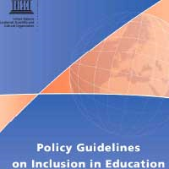
Track One Education based on Principles of Equality and Child Empowerment.
Foundations
Equality and Valuing Difference
Identifying Barriers-Finding Solutions
Collaborative Learning -Peer Support
Differentiation & Flexible Curriculum and Assessment
Stimulating and Interesting Multi-Sensory Learning Environment
Anti Bias Curriculum
Child Centred Pedagogy, Creative with Reflective Teachers
Quality education requiring rigour and effort for each child to achieve their potential

Slide 21
Track Two Education accommodating the different impairment specific needs of children with disabilities.
Blind And Visually Impaired
Braille, Tactile Maps
Tapes and Text to Talk,
Mobility Training,
Large Print, Magnification,
Orientation,
Auditory Environment &
Talking instruments
Deaf & Hearing Impaired
Sign Language Taught &
Interpretation,
Oral/Finger Spelling,
Hearing Aid Support,
Visual Environments
Speech & Communication
Facilitated Communication
Augmented Communication
Switching,
Talkers,
Information Grids.
Mental Health and Behaviour
Counselling and
Personal support,
Differentiated
Behaviour Policy, Empathy
Quiet /chill out space,
Circle of Friends,
Differentiated Behaviour Policy, Structured Day.
Deaf Blind Language,
Interpreters,
Tactile Environment,
Orientation
Physical Impairment
Accessible Infra-structure.
Toilets, Furniture
Equipment, prosthesis,
Personal Assistance
Diet, Transport,
Medication.
Specific Learning Difficulty
Colour overlays & background
Easy Read
Tapes and Text to Talk
Spell- checker
Concrete objects
General Cognitive Impairment
Pictograms, Small Steps Curriculum, Easy Read, Scaffolding, Makaton, Symbols, Info. Grids,
Concrete objects
Screening, identification and key adjustments for main impairments

Slide 22
Training routes and options for teachers’ professional development for inclusion of children with disabilities.
In-service /Continuing Professional Development- twin track.
Whole school staff training all teaching staff
Withdrawal for selected teachers to cascade to colleagues
Individual teachers undertake further award bearing study leading to Diploma, B.Ed or Masters in Inclusive Education
School based/district training with external tutor leading to additional qualification.
All need monitoring and follow up on implementation.
Leadership Training for Inclusion
Principals/headteachers and local administrators need to have training on both tracks
Training on best ways of managing and delivering training of colleagues.
Resource teachers trained in both tracks with specialism in one or more impairment specific area.
To work across a district from a local resource centre providing on going mentoring, support and monitoring
Initial or Pre-Service-twin track
College based-2 or 3 years.
Lecturers need knowledge ,skills and understanding including children with disabilities
Students need practicum in schools with good practice
School based
Need school based mentors
Distance learning using ICT,TV,DVD,
Study leave and taught courses
Teachers need decent salaries and conditions, incentives to complete additional training for inclusion and for deployment to hard to reach areas. Quality needs monitoring.

Slide 23
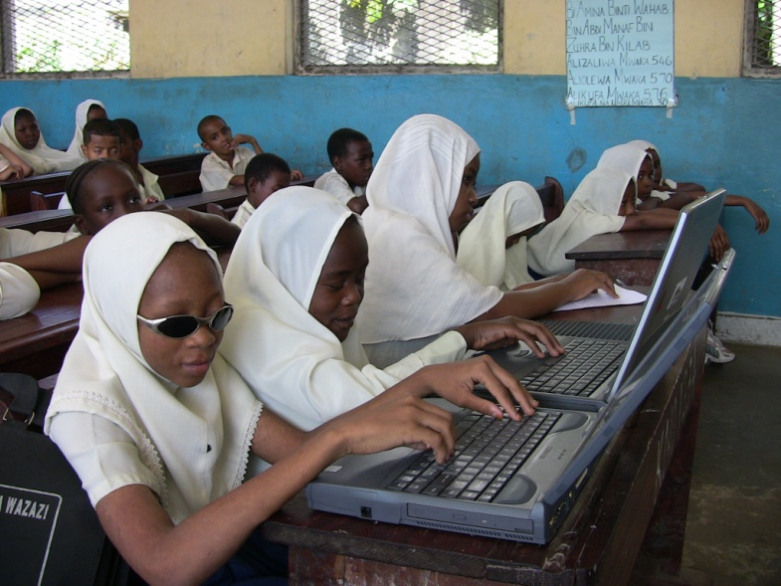
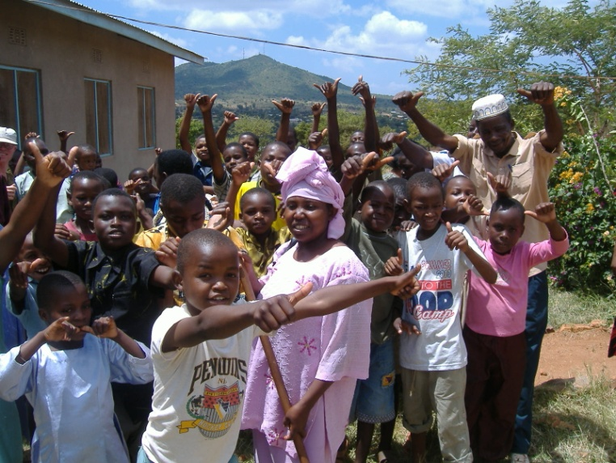
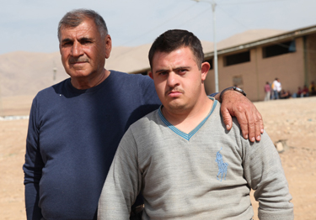
Levers of Change-1 Parents & DPOs
Parents of children with disabilities and Disabled People’s Organisations must be involved at every level.
Zanzibar Association People Developmental Disabilities
MATAJU-Inclusive Education Consortium

Slide 24
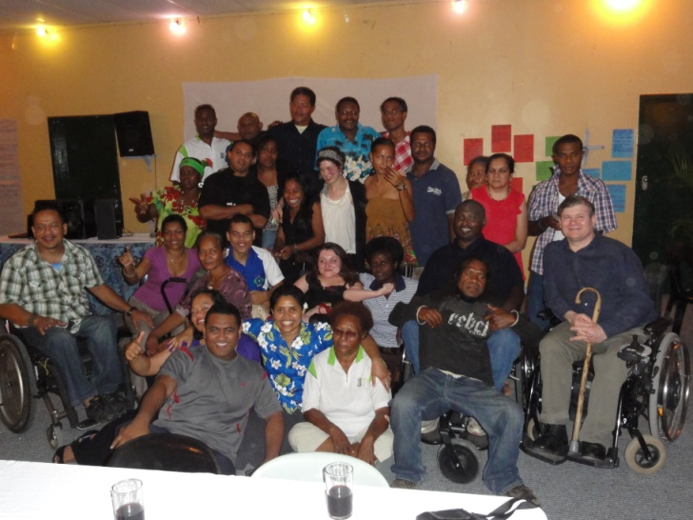
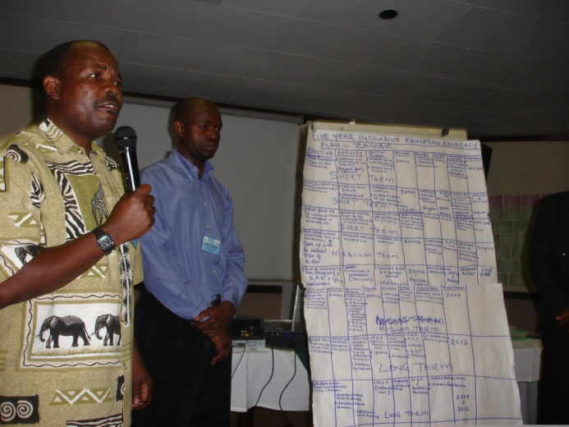
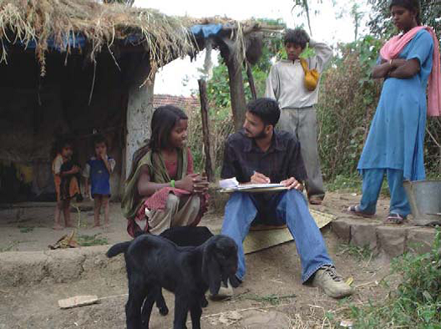
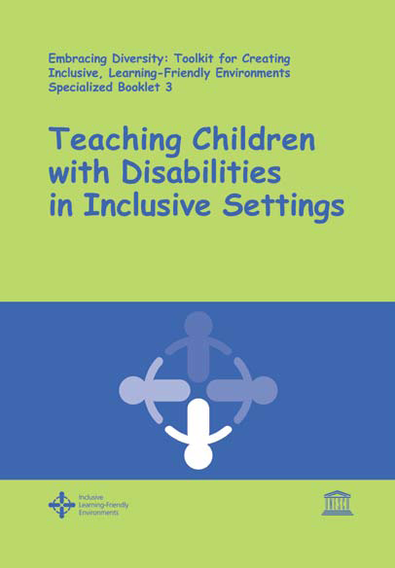

Levers of Change 2-Capacity Building
Disability
Equality
Training for
Teachers,
Parents and
Persons with
Disabilities

Slide 25
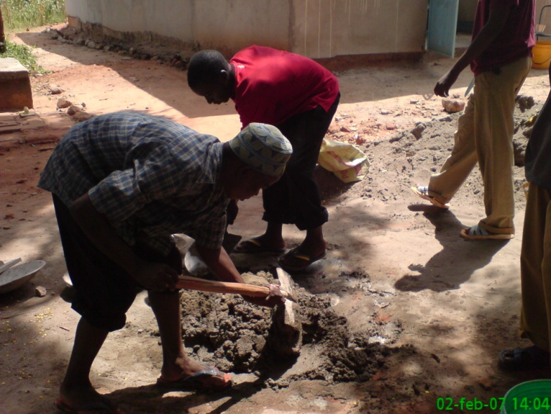
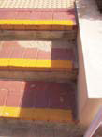
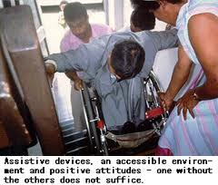

Lever 3 Mobilising Local Community
Mobilising local Community to support the inclusion of children with disabilities.
Bring resources and energy to support campaigning and making buildings accessible

Slide 26
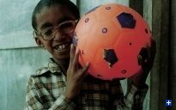
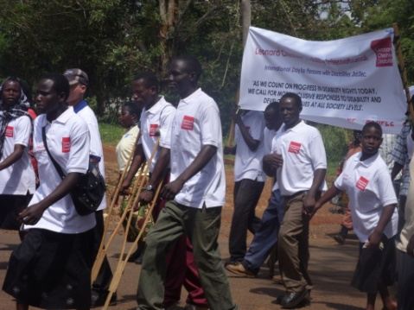
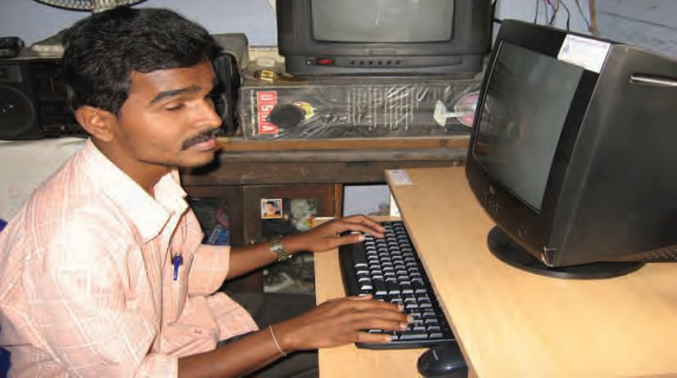
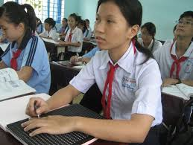
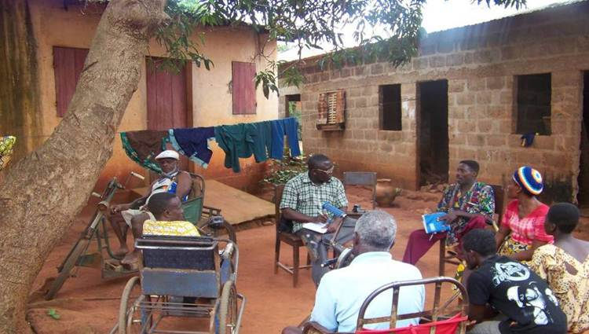
Lever of Change 4 Influencing Government
One Ministry for all children’s education.
Flexible grade system and child centred curriculum.
Incentives for families to enrol disabled children.
Recruit and train disabled teachers.
Promoting Inclusive Education in local community
Community Based Rehabilitation

Slide 27
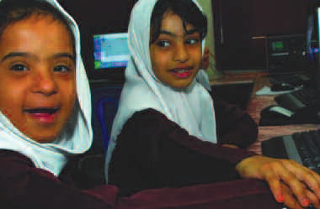
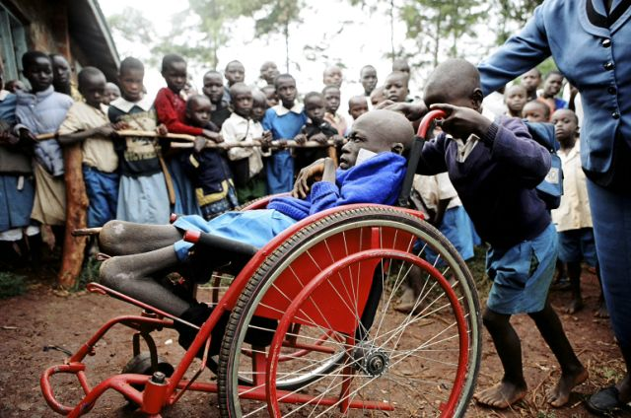
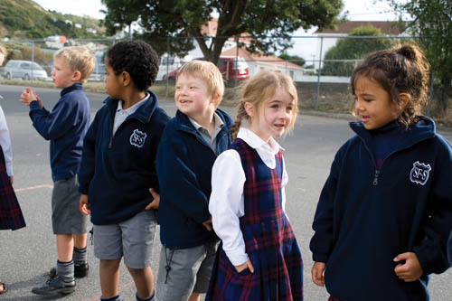
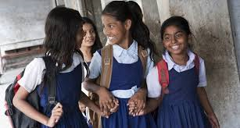
Levers of Change 5-Peer Support
The biggest and most effective resource for inclusion is mobilising peers.
UNICEF Child Friendly Schools in 190 countries. Child to Child methods have proved effective in many contexts

Slide 28
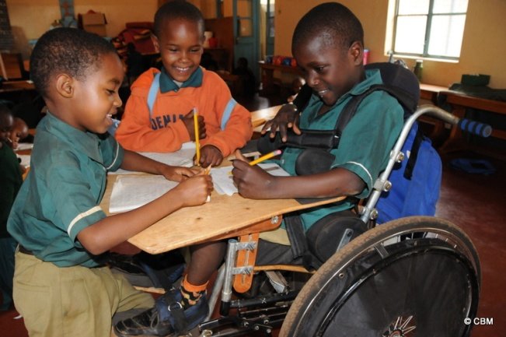
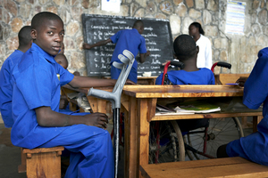
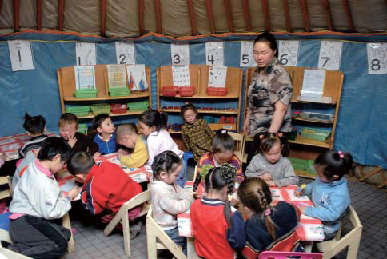
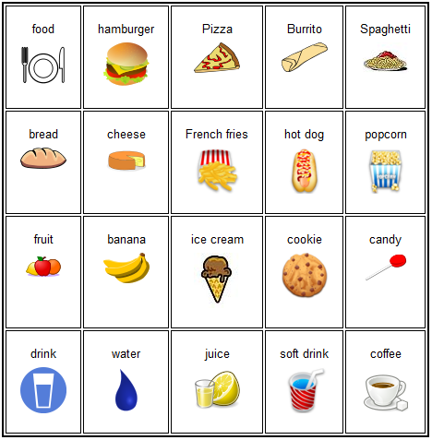
Levers of Change 6 Targeted Funding
Mobilising
International
Community to
increase aid
and donations.
Ensuring local control of funding by DPO’s and Parents.
Challenging
Corruption.
Developing Low Tech. solutions for support.

Slide 29
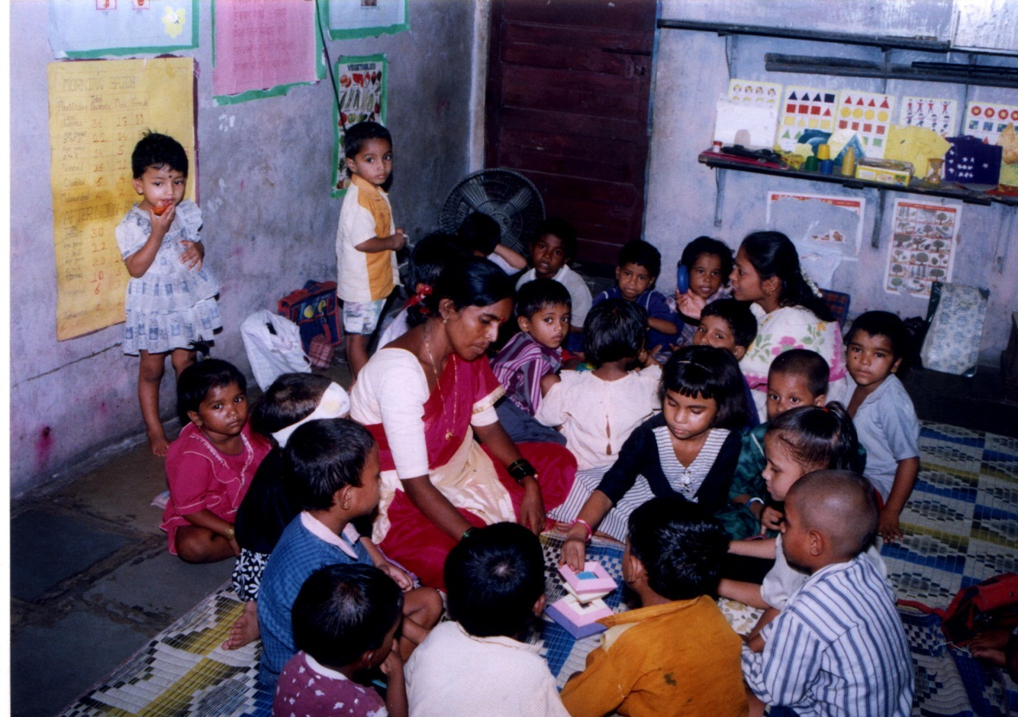
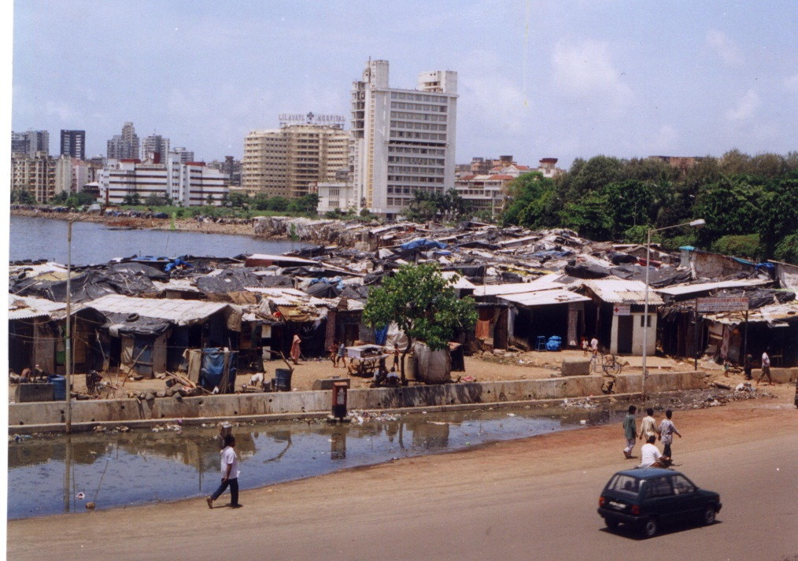
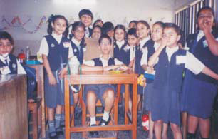
India
Dhravi, Mumbai, India
Angawadis to School
Now SSA across the whole country
2010 All disabled children a right to education

Slide 30

Schools as Centres of Care and Support (SCCS) KwaZulu Natal
The SCCS has been used and tested, both within and beyond South Africa, as a
model of mainstream care and support in education. The following key principles
have contributed to the model’s success and replicability:
•The school supports communities to respond to poverty, HIV & AIDS, conflict and gender-related issues.
•Meaningful participation by children, youth, the school and its community.
•Culturally and contextually appropriate approaches.
•Existing structures and initiatives are built on.
• A multi-sectoral partnership approach.
Integrated into government plans and budgets.
After successful pilot in Uglo district. All KZN and 5 other SADC countries now operate. MIET

Slide 31
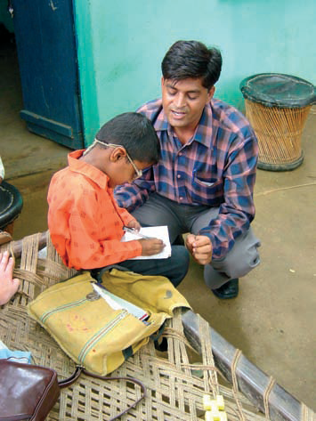
Itinerant teachers for Blind and Visual or Hearing Impaired
Programmes have been
established in several low- and middle income countries including Bangladesh, Kenya, Uganda, and Malawi.
Itinerant teachers travel to mainstream schools to provide individual tutoring in reading and writing Braille (using a frame and stylus) for blind children and those with severe low vision.
Provide other resources.

Slide 32
What is to be done?
Teachers and teacher trainers need to embrace paradigm shift to the social model of disability.
All need to develop a child friendly pedagogy
A shift in community attitudes to disability and impairment to become allies
Moves from normative testing to formative
Curriculum that reflect diversity and accommodate diversity
Build and empower capacity of Disabled Peoples Organisations
Adopt a twin track approach to including children with disability
Recognise peer support as the most powerful support
Government generalise what we know works

Slide 33
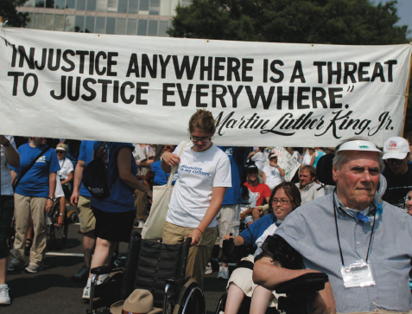
Inclusive Education is Just Education

