Slide 1

Session 2 DET of Trainers
Brighton and Hove
Richard Rieser
rlrieser@gmail.com
www.worldofinclusion.com

Slide 2
Use a Line to Match the Areas of School Policy and Practice to Disability Equality Objectives in School
Assessment 20 | 1.Impairment based name calling challenged and recorded.
2. Discipline 18 | 2.School Access Plan progressively realised.
3. Pupil Participation 6 | 3.Fund earmarked for auxiliary aids and services.
4. Anti-Bullying 1 | 4.Menus checked for allergens, different diets catered.
5. Capital-Funding 2 | 5.Positive action exercised to increase number of disabled staff in all grades.
6. Staff-Employment 5 | 6.EnsureYear and School Council has disabled representatives.
7. Curriculum 17 | 7.All venues and activities offered checked for access and barriers.
8. Teaching and Learning 11 | 8.Governors are aware of duties under Equalities Act and implement
9. School Meals 4 | 9.A variety of books age appropriate that are easy read.
10 . After School Activities 19 | 10.Fire Practice evacuates all students/Signage accessible.
11. Trips and Outings 7 | 11.All teachers take responsibility for the learning of all class pupils.
12. Governance 8 | 12.There are a variety of appropriate software and access methods.
13. Premises 10 | 13.Equalities Objectives include disability and are monitored.
14. Library 9 | 14.All learners are welcomed and different provision explained.
15. ICT 12 | 15.Class furniture and fittings flexible & adjustable for range need.
16. School Revenue Budget 3 | 16.Senior Managers promote inclusion and progress of all
17. Equalities Objectives 13 | 17.Disability is positively approached in all study areas.
18. Information for Parents 14 | 18.There is an agreed differentiated Behaviour Policy.
19. Classroom layout 15 | 19.Provision is made to support disabled pupils/students
20. Management 16 | 20.Additional time, amanuensis and different formats available

Slide 3
Set and Review Values of Organisation in light of Disability Equality Duty: Index for Inclusion
Valuing all students and staff equally.
Increasing the participation of students in, and reducing their exclusion from, the cultures, curricula and communities of local schools.
Restructuring the cultures, policies and practices in schools so that they respond to the diversity of students in the locality.
Reducing barriers to learning and participation for all students, not only those with impairments or those who are categorised as `having special educational needs'.
Learning from attempts to overcome barriers to the access and participation of particular students to make changes for the benefit of students more widely.
Viewing the difference between students as resources to support learning, rather than as problems to be overcome.
Acknowledging the right of students to an education in their locality.
Improving schools for staff as well as for students.
Emphasising the role of schools in building community and developing values, as well as in increasing achievement.
Fostering mutually sustaining relationships between schools and communities.
Recognising that inclusion in education is one aspect of inclusion in society.
http://www.csie.org.uk/resources/inclusion-index-explained.shtml

Slide 4

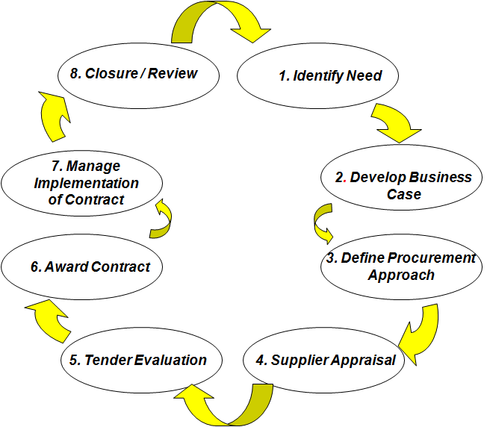
The Bicycle all process move in same direction guided by Equality and Value for Money
Procurement
Outcomes
c
Notes:
This slide is a slightly light hearted attempt to reduce the amount of internal conflict and waste caused by territorial disputes and semantics e.g. the debate between the relationship between commissioning and procurement . The point is that we are all travelling in the same direction.
By working together we can more clearly identify those areas where greater value can be gained and responsibilities such as the equality duty can be more readily achieved through effective communication and joint ownership.
Research has shown that more waste is created by internal conflict than through the relationship with third party deliverers. In the resultant turmoil, objectives such as equality duties fall off the radar.
People not working together internally on these matters, results in potential benefits and VFM not being achieved. An example is not gathering relevant equalities data and thinking it through at the start.

Slide 5
Impact on Procurement of School or Local Authority
Within your procurement activities, consider whether or not your school,authority’s overall corporate vision and aims supports
  compliance with the equality duty
  adding value by achieving wider corporate equality aims
Are relevant equality matters and the requirements of the equality duty addressed in your procurement /commissioning strategy?
What steps can you take to improve your performance?

Slide 6

Why are so few children with disabilities accessing and completing basic education? Finding from the UNICEF REAP Project 1.
Generalised approaches of the inclusion of all excluded groups are not sufficient. Education for All and Millennium Development Goal 2 have talked of All, without the specifics of the training and accommodation of meeting different impairment needs.
Reactions to categorical medical model/deficit SEN approaches has led to its replacement with generalised inclusion principles

Slide 7
Why are so few children with disabilities accessing and completing basic education? 2.
This leaves most teachers believing that the expertise for, and the inclusion of, children with disabilities, is someone else’s expertise and responsibility.
What is needed is twin track approach, with mandatory training, for all teachers on how to meet impairment specific needs, as well as, more general training on developing child friendly classrooms for all. Backed up by disability specialist local resource centres and teachers.

Slide 8

Track One Education based on Principles of Equality and Child Empowerment.
Equality and Valuing Difference
Identifying Barriers-Finding Solutions
Collaborative Learning -Peer Support
Differentiation & Flexible Curriculum and Assessment and monitoring
Stimulating and Interesting Multi-Sensory Learning Environment
Anti Bias Curriculum-Disability Equality Training
Child Centred Pedagogy, Creative with Reflective Teachers
Quality education requiring rigour and effort for each child to achieve their potential

Slide 9
Track Two Education accommodating the different impairment specific needs of children with disabilities.
Blind And Visually Impaired
Braille, Tactile Maps
Tapes and Text to Talk,
Mobility Training,
Large Print, Magnification,
Orientation,
Auditory Environment &
Talking instruments
Deaf & Hearing Impaired
Sign Language Taught &
Interpretation,
Oral/Finger Spelling,
Hearing Aid Support,
Visual Environments
Speech & Communication
Facilitated Communication
Augmented Communication
Switching,
Talkers,
Information Grids.
Mental Health and Behaviour
Counselling and
Personal support,
Differentiated
Behaviour Policy, Empathy
Quiet /chill out space,
Circle of Friends,
Differentiated Behaviour Policy, Structured Day.
Deaf Blind Language,
Interpreters,
Tactile Environment,
Orientation
Physical Impairment
Accessible Infra-structure.
Toilets, Furniture
Equipment, prosthesis,
Personal Assistance
Diet, Transport,
Medication.
Specific Learning Difficulty
Colour overlays & background
Easy Read
Tapes and Text to Talk
Spell- checker
Concrete objects
General Cognitive Impairment
Pictograms, Small Steps Curriculum, Easy Read, Scaffolding, Makaton, Symbols, Info. Grids,
Concrete objects
Screening, identification and key adjustments for main impairments

Slide 11
What is Inclusive Education ?
“Inclusive Education refers to the educational practice base on the philosophical belief that all learners, those with disabilities and those without, have a right to be educated together in age appropriate class groups, and that all will benefit from education in regular classrooms of community schools. Within these settings teachers, parents and others work collaboratively using appropriate and sufficient resources to interpret and enact the regular curriculum in a flexible manner in accordance with the individual abilities and needs of all learners.” Prof Gary Bunch Ontario

Slide 12
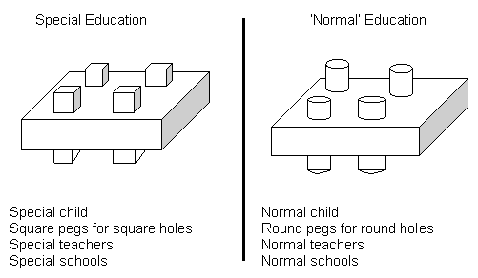
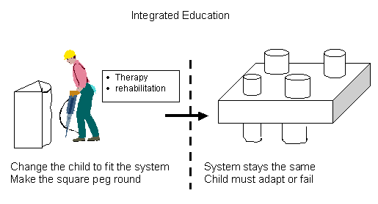
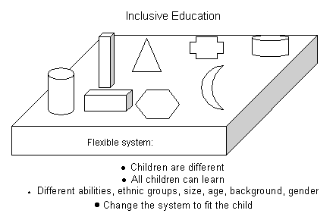
Exclusion
Segregation
?

Slide 13

Move from seeing impairment and label as determining no school or special school to schools and teachers which are flexible and where the support they need is brought to the child.
Develop child centred approach.
Teacher trained in inclusion.
Buildings and learning materials accessible.
Specialist advise and support.
Curriculum flexible.
Peer support.
Community educated for inclusion.
Special schools become resource centres.

Slide 14
In the Social Model It's the barriers that disable !
Negative
Attitudes
Inaccesible
Environments
Bullying
Use of Resources
Poor Peer Support
Inflexible Curriculum
Lack of Communication
Lack of Role Models
Ignorance
Poor Teaching
Fear
Low Expectations

Slide 15
Environment
Organisation,
Teaching &Curriculum
Find Barriers and then
After film Solutions
Attitudes & Culture
School
Medical, Personal &
Equipment Needs

Slide 16
The principles of school inspection as described in the ‘Framework for School Inspection’, Sept. 2012
“that the inspection will focus on the needs of pupils and parents by evaluating the extent to which schools provide an inclusive environment which meets the needs of all pupils irrespective of age, disability, gender reassignment, race, religion or belief, sex or sexual orientation. The ‘Ofsted School Inspection Handbook’, September 2012 states that inspectors will request logs of racist incidents and incidents of bullying, including homophobic bullying. Under the Behaviour and Safety judgement of the Ofsted Evaluation Schedule inspectors are asked to consider:
types, rates and patterns of bullying and the effectiveness of the school’s actions to prevent and tackle all forms of bullying and harassment – this includes cyber-bullying and prejudice-based bullying related to special educational need, sexual orientation, sex, race, religion and belief, gender reassignment or disability
the effectiveness of the school’s actions to prevent and tackle discriminatory and derogatory language – this includes homophobic and racist language, and language that is derogatory about disabled people.

Slide 17
Bullying Brighton and Hove 20112-July 2013
 | Appearence | Dis/SEN/Medical | Home Circ. | Gender Id. | Race Ethnic | Religion/Belief | Sex | Sex Orientation | Other | Total
Pri Total | 44 | 13 | 9 | 16 | 122 | 14 | 9 | 71 | 151 | 449
Sec | 101 | 75 | 4 | 27 | 96 | 10 | 11 | 41 | 262 | 627
Special | 3 | 0 | 0 | 0 | 1 | 0 | 1 | 0 | 18 | 23
All Sch. AnnualTotal | 148 | 88 | 13 | 13 | 219 | 24 | 21 | 112 | 431 | 1099
91 % Schools made a return Dec 31st 2013 Source Sam.beal@brighton-hove.gov.uk

Slide 18
Prejudice-based incidents and bullying can be perpetrated using the following behaviours:
Cyberbullying- Internet, mobile phones, blackberry messenger, social media
Damage to property-Damage, interference, withholding, demanding or stealing of personal possessions, money and loaned or allocated equipment/resources, graffiti
Indirect / social -Not being spoken to or being excluded, or left out of activities, gossiping, spreading rumours, dirty or intimidating looks, gestures
Physical Pushing, kicking, hitting, pinching, tripping, spitting or any other form of violence or physical force.
Possession distribution of offensive materials This could be materials or publications that seek to promote extremist and prejudiced views such as racist literature.
Sexual abuse / harassment Suggestive sexual comments or innuendo including offensive comments about sexual reputation; or using sexual language that is designed to subordinate, humiliate or intimidate, groping / inappropriate touching
Verbal Abuse Using language in a derogatory or offensive manner, such as name calling, sarcasm, personal threats, nasty comments or ‘jokes’ or
persistent teasing and taunting

Slide 19

Person Centred Planning and Peer Support
Person centred planning keeps the person at the centre of things
The person, says what they hope for and makes plans, with the support of other people who are important to them
Services will often need to change and do things in new ways, if plans are going to be put into practice.

Slide 20
PATH - Planning Alternative Tomorrows with Hope
Using the focus person's dreams as a starting point, a PATH is used to help plan the steps necessary to achieve those dreams and aspirations. The PATH helps to make clear who's help is needed, how to go back enrolling appropriate assistance, who will help with what, the first steps to be taken, 6 monthly goals and so on.

Slide 21
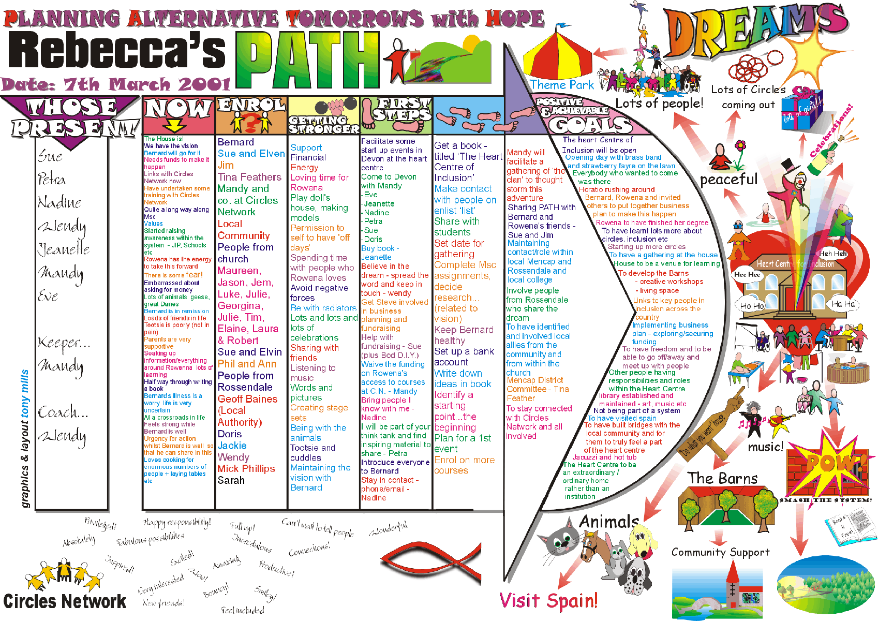
Sample PATH - Planning Alternative Tomorrows with Hope
Using the focus person's dreams as a starting point, a PATH is used to help plan the steps necessary to achieve those dreams and aspirations. The PATH helps to make clear who's help is needed, how to go back enrolling appropriate assistance, who will help with what, the first steps to be taken, 6 monthly goals and so on.
Copyright Circles Network © 2005

Slide 22
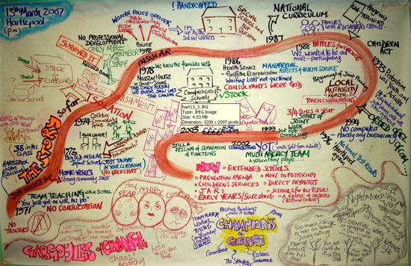
We can join with you and your organisation

Slide 23
Relationship Map/ Circles of Friends
Relationship maps are used to find out who is currently involved with the focus person's life and in what capacity. By mapping relationships in this way, it allows conscious changes and developments to be planned and made to the benefit of the focus person

Slide 24
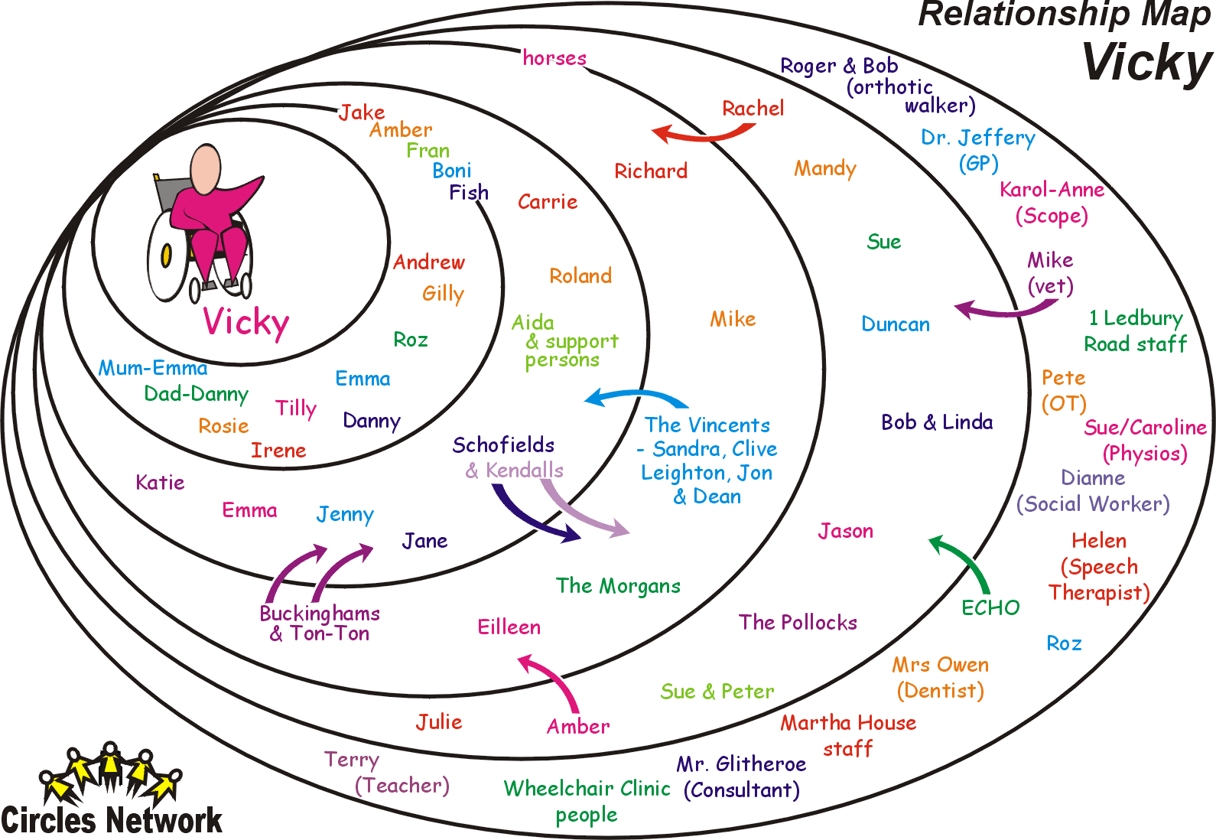
Copyright Circles Network © 2005

Slide 25
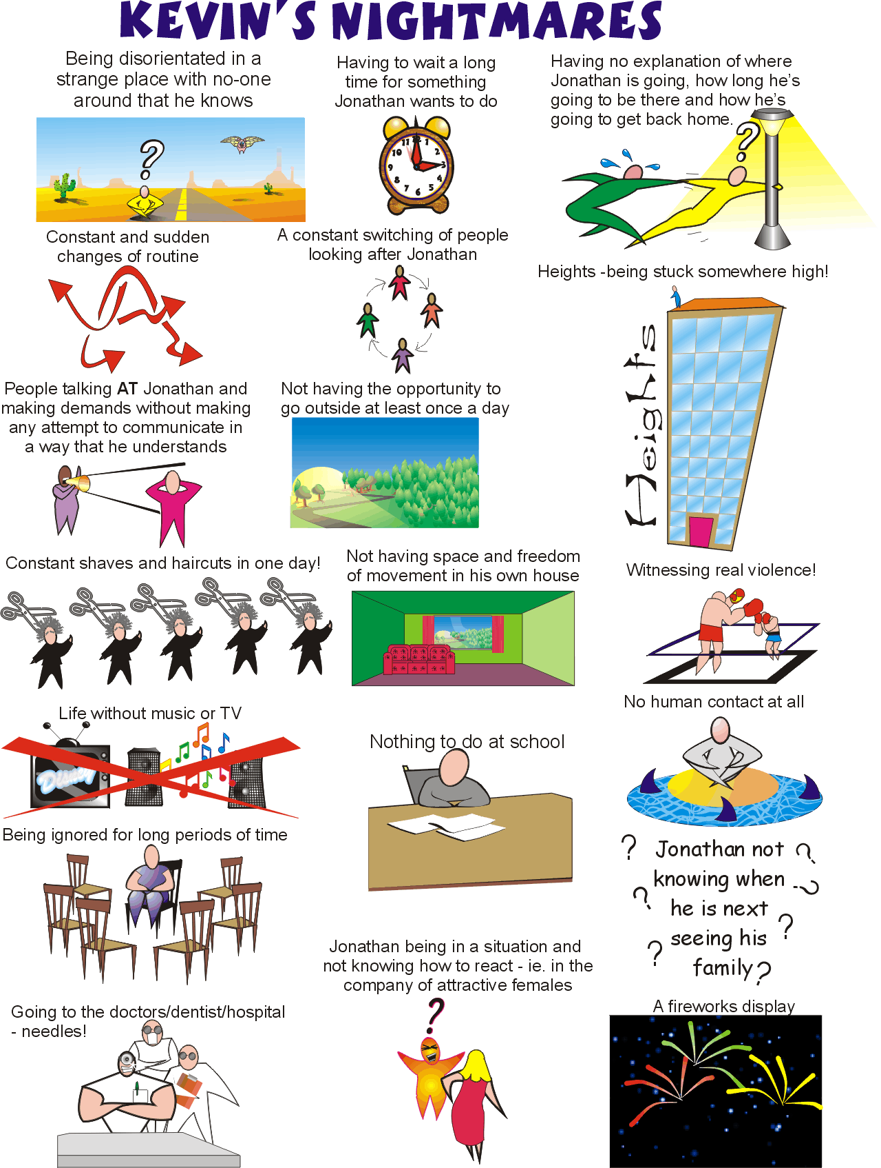
Sample MAP Pages

Slide 26
Person Centred Transition Planning
MAPS and PATH. These tools can replace review and transitional planning processes for many young people with high support needs and can break in to destructive cycles of blame and exclusion around young people labelled as 'trouble'.

Slide 27
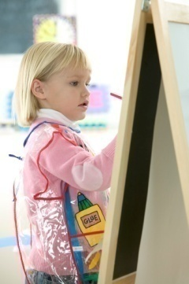


Make a diary of the school day- Find out for each activity whether it is enjoyed-liked, disliked or unconcerned

Slide 28
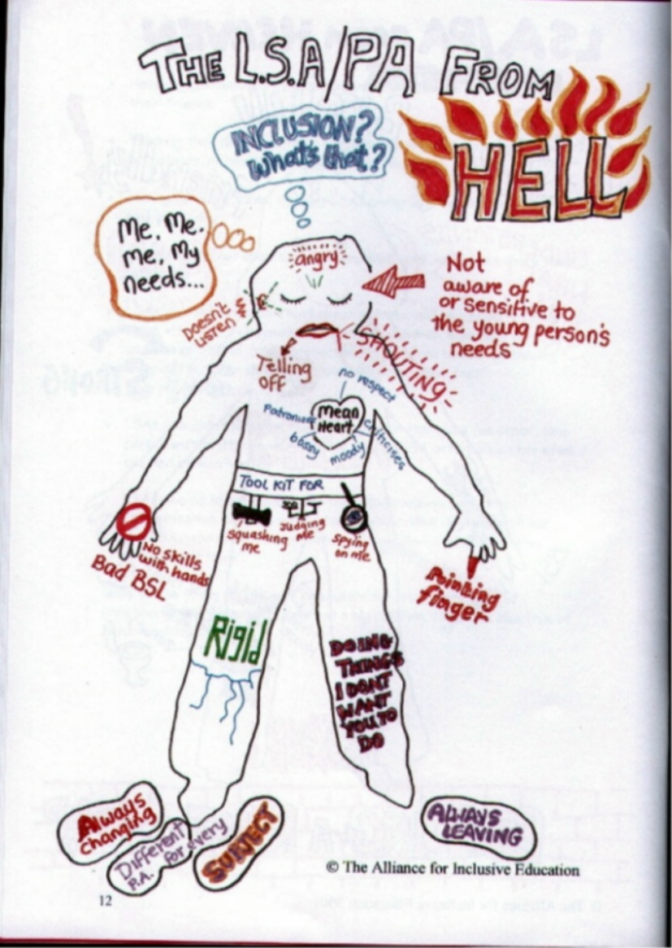
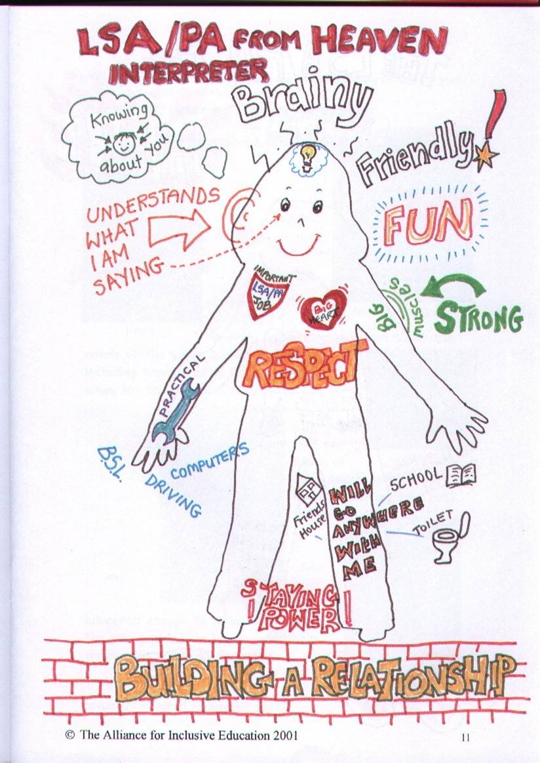
Notes:
14 young people who between them had had more than 100 teaching assistants

Slide 29

Nadia Clarke
Nadia has cerebral palsy and is deaf.
When she was aged 6 her parents moved 100 miles to Halifax as the local Authority had signed the Salamanca statement and said they could accommodate her.
Last July she got 2 GCSE’s and is now in college studying BTEC social and health care
"Now I'm off to college and then after that uni, I hope, maybe travel the world for a year, and then go on to my dream of working in healthcare."

Slide 30



