Slide 1

Disability Equality Training of Trainers: Brighton and Hove
Richard Rieser
World of Inclusion
www.worldofinclusion.com
rlrieser@gmail.com

Slide 2
What do you know about disabled people?
1.How many disabled people does the Government estimate there are in UK?
5 million
8.7 million
10.5 million
12 million
20 million
2.How many disabled people are there estimated to be in the World
250 million
430 million
680 million
810 million
1082 million

Slide 3
What do you know about disabled people?
3. What is the most common impairment?
Hearing impairment
Visual impairment
Arthritis
Back pain
Mental Health Issues
Learning Difficulty
4. What is the largest category of disabled pupils in mainstream primary & secondary schools?
Autistic
Moderate Learning Difficulty
Dyslexia and specific learning difficulty
Behavioural Emotional and Social Difficulty
Speech ,Language & Communication
Physical and Sensory impairment

Slide 4
What do you know about disabled people?
5.What percentage of disabled pupils claim to have been bullied at school?
15%
33%
52%
74%
81%
6. How many times more or less than non-disabled pupils are disabled pupils likely to be excluded?
Half as likely
2 x
5 x
7 x
9x

Slide 5
Disabled Pupils Facts and Figures-1
In 2010/11 Pupils with SEN with statements are around 9 times more likely to be permanently excluded than those pupils with no SEN.
The number of pupils with statements of SEN receiving one or more fixed period exclusions is six(6.7 x) times higher than for pupils with no SEN.
In 2010/11 the proportion of pupils with SEN without a statement achieving 5 or more A*-C grades at GCSE or equivalent including English and mathematics GCSEs is 24.7 per cent, compared to 8.5 per cent of pupils with SEN with a statement, and 69.5 per cent of pupils with no identified SEN. Gap increased in the last 3 years.
English Baccalaureate is 16.8 percentage points – 19.4 per cent of pupils with no identified SEN achieved this compared with 2.6 per cent of pupils with SEN.

Slide 6
Disabled Pupils Facts and Figures-2
2010/11 KS2 Combining the SEN categories into one group, 35 per cent of all pupils with SEN achieved Level 4 or above in both English and mathematics in 2011, compared with 87 per cent of pupils with no identified SEN. The attainment gap between pupils with SEN and those without is now 52 percentage points. This has narrowed by 2 percentage points from last year and by 3 percentage points since 2007.
2010/11 Foundation For pupils with SEN (both without a statement and those with a statement of SEN), 21 percent achieved a good level of development compared with 63 percent for those pupils with no identified SEN. This is a difference of 43 percentage points; wider than in 2010 when it was 41 percentage points.
Bullying(EHRC-2004-2006)Young people with a disability or SEN were most at risk of being bullied. More than four-fifths of young people with a statement of SEN (83%) or a disability that affected their schooling (81%) reported having been bullied in 2004-06, compared to under two-thirds (65%) of young people with no SEN or no disability.

Slide 7
Definition of Disabled Person
The Act says that a person has a disability if they have a physical or mental impairment which has a long term and substantial adverse effect on their ability to carry out normal day-to-day activities.
Disregard aids, medication and treatment
Physical or mental impairment includes sensory impairments such as those affecting sight or hearing and severe disfigurement.
A long term means that the impairment has lasted or is likely to last for at least 12 months or for the rest of the affected person’s life.
Substantial means more than minor or trivial.

Slide 8
Which of the following would you think is a disabled person?
1.A person with cerebral palsy | 2. A Deaf person | 3.Someone who uses a hearing aid
4 A person with influenza | 5. A person who has had polio | 6. Someone with HIV
7.Someone with chicken pox | 8. Someone with a heart condition | 9. Someone who needs glasses to read
10.Someone who has Down’s Syndrome | 11.An amputee | 12.Someone with cancer
13. Someone with Oppositional Defiance Disorder | 14. Someone with Asthma | 15.Someone who is Bi-polar(Manic Depression)
16. Someone with Type II Diabetes | 17. Someone with a bad cold | 18.Someone with measles
19. Someone who is Dyslexic | 20. Someone with Depression | 21. A spinally injured person
22. A blind person | 23. A visually impaired person e.g. tunnel vision | 24. Someone who stutters
25.A fractured bone | 26.Someone with toothache | 27.kidney failure
28. Developmental Coordination Disorder | 29. A wheelchair user | 30. Sensory Processing Disorder
31. Someone with Learning Difficulty | 32. Someone with a burnt face. | 33. Someone with Cystic Fibrosis

Slide 9

PLASC Data England 2013 by type of school & impairment
 | Primary | Sec. | Special M&NM | Total
SpLD | 3O,360 | 39,205 | 1,090 | 70,660
MLD | 67,670 | 53,445 | 17,225 | 138,355
SLD | 4,410 | 2,185 | 23,845 | 30,440
PMLD | 1,530 | 230 | 8,695 | 10,525
BESD | 61,390 | 68,530 | 13,130 | 143,050
Sp.LCom. | 102,185 | 24,900 | 5,120 | 132,210
VIHIMS | 12,620 | 11,300 | 2,425 | 26,365
PD | 13,510 | 9,635 | 3,540 | 26,685
ASD | 25,880 | 24,165 | 20,735 | 70,780
other | 14,125 | 14,070 | 825 | 29,015
Total | 274.0k | 247.7 | 96.6k | 678,08
Total SEN
Secondary 18.9%
Primary 17.4%
School Action
360,665
secondary pupils
416,060
primary pupils
+
Those with Medical
Needs- e.g. Diabetes,
Asthma, Allergy
+
Mental Health Issues e.g.
Depression
Eating Disorders
Self- Harmers
Source DFE Table 11. SFR14/2013
Notes:
Emphasis the large groups in mainstream Moderate Learning Difficulty, Behaviour Emotional and Social Difficulty, Specific Learning Difficulty, Speech Language and Communication. The traditional groups Sensory Impaired and Physically impaired are in a minority.
These are all pupils on School Action Plus and Statements.
There are only 15.2% in state special schools.

Slide 10
YEAR | Total Pupils | Nos. Statement | %ST | % ST in Main | Nos. SEN No state | Nos. in Special Sch. | State in Ind +PRU | Nos. Special Schools
1994 | 7,882,835 | 194,541 | 2.5 | 51.8 | - | 98,973 | 5,458 | 1310
1995 | 8,107,830 | 211,307 | 2.6 | 53.6 | 792,233 | 98,390 | 7,151 | 1291
1996 | 8,116,543 | 227,307 | 2.8 | 56 | 1,103,426 | 98,076 | 7,638 | 1263
1997 | 8,194,964 | 234,629 | 2.9 | 57.2 | 1,222,973 | 98,249 | 8,154 | 1239
1998 | 8,260,582 | 242,294 | 2.9 | 58.4 | 1,331,219 | 98,427 | 8,248 | 1229
1999 | 8,310,476 | 284,041 | 3.0 | 59.5 | 1,409,811 | 97,693 | 8,747 | 1209
2000 | 8,345,815 | 252,857 | 3.0 | 60.5 | 1,465,106 | 96,570 | 8,582 | 1197
2001 | 8,374,100 | 258,200 | 3.1 | 61.1 | 1,556,156 | 95,600 | 8,400 | 1175
2002 | 8,369,081 | 248,982 | 3.0 | 60.2 | 1,401,995 | 94,467 | 8,813 | 1161
2003 | 8,366,780 | 250,550 | 3.0 | 60.3 | 1,169,780 | 93,880 | 9,000 | 1160
2004 | 8,344,880 | 247,590 | 2.9 | 60.3 | 1,197,490 | 91,770 | 10,100 | 1148
2005 | 8,274,470 | 242,580 | 2.9 | 59.6 | 1,230,800 | 90,370 | 10,190 | 1122
2006 | 8,215,960 | 236,750 | 2.9 | 59.2 | 1,293,250 | 89,390 | 10,500 | 1105
2007 | 8,167,715 | 232,760 | 2.8 | 57.7 | 1,344,505 | 91,750 | 10,920 | 1077
2008 | 8,121,955 | 227,315 | 2.8 | 56.7 | 1,402,895 | 91,830 | 11,315 | 1065
2009 | 8,092,280 | 225,400 | 2.8 | 56.1 | 1,447,205 | 92,270 | 11,920 | 1056
2010 | 8,098,360 | 223,945 | 2.8 | 54.8 | 1,481,035 | 93,230 | 11,380 | 1050
2011 | 8,123,865 | 224,210 | 2.8 | 54.3 | 1,449,685 | 94,275 | 11,445 | 1046
2012 | 8,178,200 | 226,200 | 2.8 | 53.7 | 1,392,215 | 95,915 | 12,240 | 1039
2013 | 8,249,810 | 229,390 | 2.8 | 53.0 | 1,316,220 | 98,595 | 12,895 | 1032

Slide 11
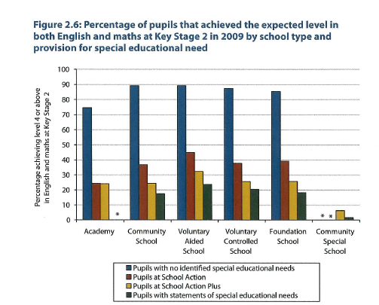

Slide 12

Achievement by type of special educational need comparing community schools and special schools in England at key stage 2 and key stage 4, 2009/2010-School Action Plus and Statement
 | Community Special Ks2 Level 4 | Community Prim. KS2 Level 4 | Com. Second 5 GCSE A+-C inc E&M | Com Special 5GCSE A+C Inc E&M | Com Sec 5 A-G in E&M | Com Special 5A-G incl E&M
All SEN | 2% | 36% | 17% | 0% | 70% | 7%
MLD | 0% | 20% | 4% | - | 70% | 2%
Autism | 2% | 46% | 25% | 1% | 84% | 7%
BESD | 11% | 50% | 14% | 0% | 64% | 17%
HI | 0% | 49% | 36% | - | 89% | 20%
VI | 5% | 58% | 42% | - | 90% | 33%
PD | 2% | 53% | 33% | - | 86% | 9%
Nos. 1–5 suppressed
Source: Safeguarding and Vulnerable Children Analysis Team, Analysis and Research Division, Children, Young People and
Families Directorate, UK Department for Education, 2010.

Slide 13
Equality Strands
When referring to equality and diversity this covers all the equality strands used by the Equality and Human Rights Commission (EHRC) and includes social aspects such as poverty and deprivation. The 9 strands or protected characteristics are:
age, (not in provision of education)
disability,
gender,
maternity and breastfeeding
faith and religious belief including no belief,
race, ethnicity or nationality
sexual orientation,
transgender
Civil partnership and marriage
(http://www.equalityhumanrights.com).
Applies to those associated with or perceived to be e.g. Parents of a disabled child or child of lesbian parents

Slide 14
Disability Equality Duties for schools
For pupils, prospective and past pupils, staff, parents schools are under a general equality duty to eliminate:
Direct discrimination,
Indirect discrimination,
Discrimination arising from a disability
A duty to make reasonable adjustments for disabled people, (including auxiliary aids from 2012).
Protection from harassment and victimisation
Positive action and more favourably action for groups shown to be discriminated against
Duty continues to have a school Access Plan
Disability Only

Slide 15
Factors Reasonable Adjustment
It covers everything in and around the school Taking reasonable steps to policies, criteria and practices to avoid detriment or substantial disadvantage to a disabled pupil such as:-
Time and effort expended
Inconvenience, indignity or discomfort
Loss of opportunity or diminished progress.
Is it more than minor or trivial?

Slide 16
There is no justification for not making
adjustments.
The question is only whether
or not the adjustment is reasonable.
Reasonable adjustments,
Factors that may be taken into account:
The extent to which support will be provided to the disabled pupil under Part 4 of the
Education Act 1996 (the SEN framework) or 2014 Children Families Act
The resources of the school and the availability of financial or other assistance
The financial and other costs of making the adjustment
The extent to which taking any particular step would be effective in overcoming
the substantial disadvantage suffered by a disabled pupil
The practicability of the adjustment
The effect of the disability on the individual
Health and safety requirements
The need to maintain academic, musical, sporting and other standards
The interests of other pupils and prospective pupils.
Notes:
Reasonable adjustments and ‘factors’
The factors that may be taken into account, DRC Code p65, para 6.28, may limit what a school might be required to do under the duties, but they do not relieve the responsible body of the need to identify a reasonable adjustment to make sure that a disabled pupil is not placed at a substantial disadvantage.
Some of these factors may appear to limit the duties, but, for example a consideration of standards may dictate that a disabled pupil should participate in a particular activity, not that the pupil might be excluded from it. Examples:
standards, DRC Code p67, example 6.34A (include);
interests of other pupils, DRC Code p68, example 6.34B (exclude);
health and safety, DRC Code p69, example 6.34C (balancing).

Slide 17
Duty to Promote Disability Equality

Slide 18
Duty to provide Auxiliary Aids and Services to Disabled Pupils/Students.
This is and anticipatory duty therefore schools need to think in advance about what disabled pupils/students might require and what adjustments might need to be made for them.
All disabled pupils and students are owed this Duty.
Unlike the graduated approach of SEN it should be in place from when start at establishment.
Examples-coloured overlays for dyslexic pupils,
pen grips, adapted PE equipment, adapted keyboards and computer software.

Slide 19
Direct Discrimination Case Study 1
A young people’s drama group that organises theatre trips and productions for its members turns down an application for membership from a girl with a hearing impairment as they believe she would not get the same benefits as other members. Although, the association may be well-intentioned in rejecting her membership application. Is this Direct Discrimination?

Slide 20
Disability Discrimination claims upheld so far….some issues
assumptions about disabled pupils
risk assessments
administration of medicines
school trips
Failure to provide auxiliary aids and services
behaviour related to disability
bullying and isolation from peers
access to the curriculum
admissions

Slide 21
Direct Discrimination Case-1
A diabetic boy wishes to join his local football club, but he is rejected because they consider his condition and that his parents are a lesbian couple.
Is this is direct discrimination by association?
because of sexual orientation because of the boy’s association with his parents?
Or is it a claim on 2 grounds?
Or both?

Slide 22
Disability Discrimination Case Study 2
A teenager with Downs Syndrome is a member of a swimming club. He asks whether he can join the club’s tournament team, but is told his swimming is not good enough. Another club member with the same swimming achievements as him, who doesn’t have this disability, is selected for the team.
Who would be the comparator for less favourable treatment? And why?

Slide 23
Indirect Discrimination
Applies to all protected characteristics apart from maternity and pregnancy
Indirect discrimination may occur when a school or service provider applies an apparently neutral provision, criterion or practice which puts persons sharing a protected characteristic at a particular disadvantage. s.19(1), 19(2)
service provider cannot show that the provision, criterion or practice is justified as a proportionate means of achieving a legitimate aim.

Slide 24
Indirect Disability Dis.Case Study3
A school internet newspaper, which contains news, children’s cartoons and stories, establishes a website to enable children to access it more easily. However, the website has all of its text embedded within graphics. Although, it did not intend to discriminate indirectly against those with a visual impairment, this practice by the school places those with a visual impairment and others at a particular disadvantage because they cannot change the font size or apply text-to-speech recognition software. They therefore cannot access the website.
Is this Indirect discrimination?

Slide 25
Indirect Disability Dis.Case Study 4
A boy on the autistic spectrum is in the dinner queue And some scuffling takes place the midday supervisor says “stop messing about”. He continues as the boy behind him has pushed him. The Midday Supervisor(MS) says Pull your socks up or you’ll be in trouble. Things escalate as he feels he is being treated unfairly. THE MS pulls him out of the line. He hits her. She takes him to the head . He says this is the third time I have seen you for bad behaviour and suspends him.
Is this disability discrimination

Slide 26
Discrimination arising from disability 5
A mother seeks admission to a privately run nursery for her son who has Hirschsprung’s disease, which means that he does not have full bowel control. The nursery says that they cannot admit her son because he is not toilet trained and all the children at the nursery are.
Why is this discrimination arising from disability?
The refusal to admit the boy is not because of his disability itself; but he is being treated unfavourably because of something arising in consequence of his disability.

Slide 27
Discrimination arising from disability-6
A headteacher of an Academy refuses to admit a girl who uses a wheelchair as he claims it will not be safe during periods of lesson change.
Is this a proportionate means of achieving a legitimate aim?
When would it be a proportionate means of achieving a legitimate aim?

Slide 28

Scapegoating: Where does it come from?
81% of 16 year olds with a statement report bullying
75% of LGBT 16 year olds
70% Muslim students
65% of all 16 yr olds
What should be done to stop bullying of disabled people in school?
Educate for Zero Bullying
Involve young people
Understand where the oppression comes from
Always challenge it! Ofsted
Support UK Disability History Month
Othering- process –Adorno, Social Psychologist
Unwanted comments and name calling
Jokes at disabled persons expense
Exclude from social group
Discriminate
Violence
Death
All is run by projecting onto others your own worries and insecurities
Increases at times of economic and social dislocation.

Slide 29
Bullying and Oppression. What needs to be done!
Create a school culture that does not accept bullying-Respect
Monitor and record all incidents.
Develop an understanding of oppression and its impact historically.
Develop an understanding of what sexist, racist, trans, homophobic, disabilist, anti-semitic, islamaphobic and cyber bullying leads to.
If an incident occurs stop the lesson to discuss it
Fully involve pupils-peer mediators, bully busters, Form and Year Councils
Staff to model the behaviour they expect
Share what you are doing with local community and parents.

Slide 30
General Public Sector Equality Duty
There is a General Public Sector Equality Duty when taking decisions about policies, criteria and practice to give due regard to the need to :
eliminate discrimination, harassment, victimisation
advance equality of opportunity between persons
tackle prejudice and promote understanding for pupils, staff and others using school facilities
Positive action and more favourably action for groups shown to be discriminated against
www.equalityhumanrights.com/en/publications andresources/disability/pages/education.aspx

Slide 31
General Duty Brown Principles apply to governors and LA
1 Decision-makers must be made aware of their equality duties;
2 Equality must be considered at the time that decisions are made;
3 Analysis must be rigorous;
4 Non-delegation;
5 Ongoing;
6 Record-keeping –dated and evidence taken into account
All have a general duty of care.

Slide 32
Specific Public Sector Duty
There is a Specific Duty on all state funded schools and nurseries to have an equality policy, including academies and free schools, from 6thApril 2012.
One or more objective and show the data that led o choice of objectives. These must be available to public and lasts 4 years? Government Consultation
There is a general Public Duty when taking decisions about policies and practice to pay due regard to the need to :
eliminate discrimination, harassment, victimisation
advance equality of opportunity between persons
tackle prejudice and promote understanding.

Slide 33
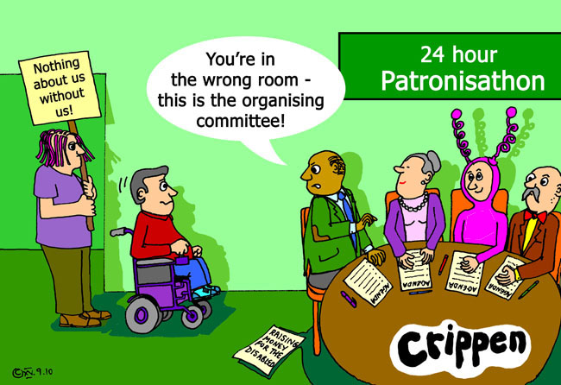

Slide 34
The dominant view is the
Medical Model.
CHILD DEVELOPMENT TEAM
SPECIALISTS
SOCIAL WORKERS
DOCTORS
SURGEONS
GPs
THE IMPAIRMENT
IS THE PROBLEM
SPECIAL TRANSPORT
SPEECH THERAPISTS
EDUCATIONAL PSYCHOLOGISTS
OCCUPATIONAL THERAPISTS
SPECIAL SCHOOLS
SHELTERED WORKSHOPS
BENEFITS AGENCY
TRAINING CENTRES
DISABLED PEOPLE AS PASSIVE RECEIVERS OF SERVICES AIMED AT CURE OR MANAGEMENT

Slide 35
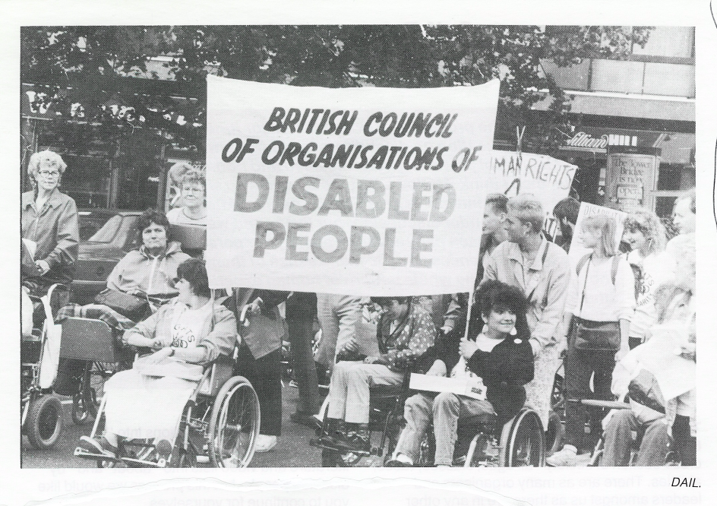
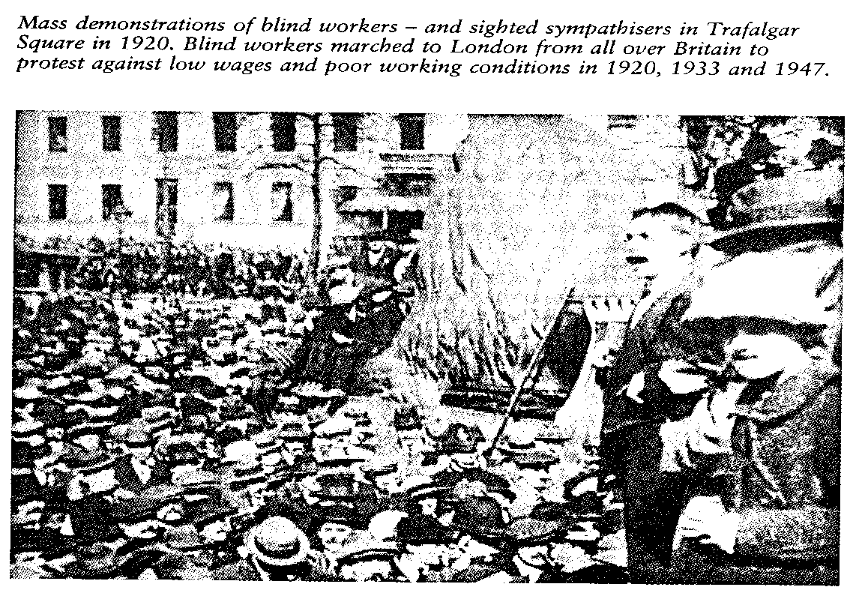
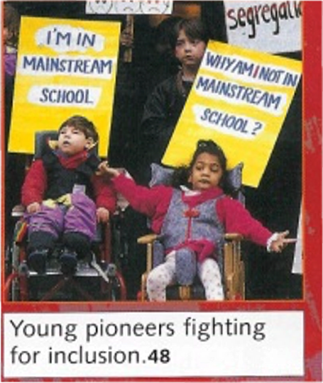
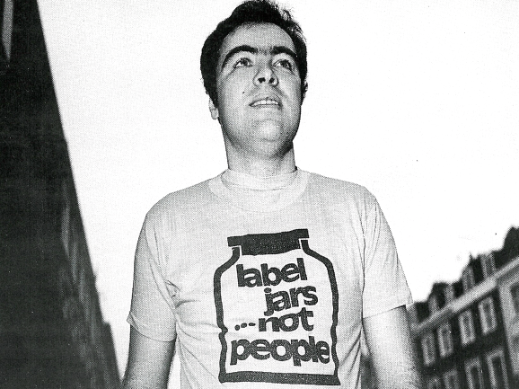
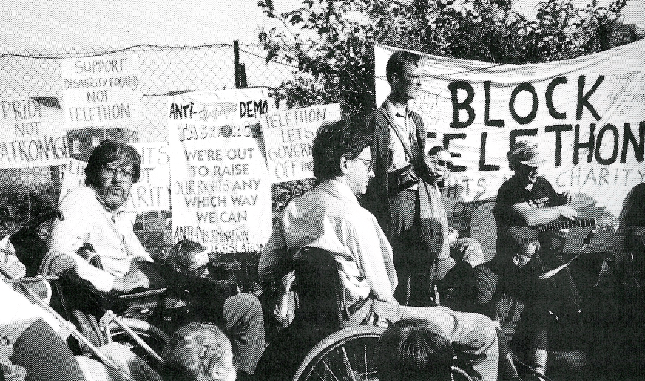
1920, 1933, 1947 Demonstration for the Right to Work and for decent wages and conditions for Blind Workers
British Council Disabled People 1972
Disabled People Organise and Fight Back
People First- People with learning Difficulties 1984

Slide 36
The Social Model of disablement focuses on the barriers
LACK OF USEFUL EDUCATION
DISCRIMINATION IN EMPLOYMENT
INACCESSIBLE ENVIRONMENT
SEGREGATED SERVICES
THE STRUCTURES WITHIN
SOCIETY ARE THE PROBLEM
DE-VALUING
POVERTY
‘BELIEF’ IN THE MEDICAL MODEL
PREJUDICE
INACCESIBLE TRANSPORT
INACCESSIBLE INFORMATION
DISABLED PEOPLE AS ACTIVE FIGHTERS FOR EQUALITY
WORKING IN PARTNERSHIP WITH ALLIES.

Slide 37
Medical and Social Model Thinking applied to education^{[1]}
^{[1]} Adapted from Micheline Mason 1994, Altogether Better, Comic Relief & R. Rieser 2000
MEDICAL MODEL THINKING | SOCIAL MODEL THINKING
Child is faulty | Child is Valued
Diagnosis | Strengths and Needs defined by self and others
Labelling | Identify Barriers and develop solutions
Impairment becomes Focus of attention | Outcome based programme designed
Assessment, monitoring, programmes of therapy imposed | Resources are made available to Ordinary services
Segregation and alternative services | Training for Parents and Professionals
Ordinary needs put on hold | Relationships nurtured
Re-entry if normal enough or Permanent Exclusion | Diversity Welcomed Child is Included
Society remains unchanged | Society Evolves

Slide 38
It's the barriers that disable !
Negative
Attitudes
Inaccesible
Environments
Bullying
Use of Resources
Poor Peer Support
Inflexible Curriculum
Lack of Communication
Lack of Role Models
Ignorance
Poor Teaching
Fear
Low Expectations

Slide 39
Shifting the Focus at UN
“Recognizing that disability is an evolving concept and that disability results from the interaction of persons with impairments and attitudinal and environmental barriers that hinders their full and effective participation in society on an equal basis with others.”
Paradigm Shift -Persons with disabilities are not viewed as "objects" of charity, medical treatment and social protection; rather as "subjects" with rights, who are capable of claiming those rights and making decisions for their lives based on their free and informed consent as well as being active members of society.
http://www.un.org/disabilities/

Slide 40


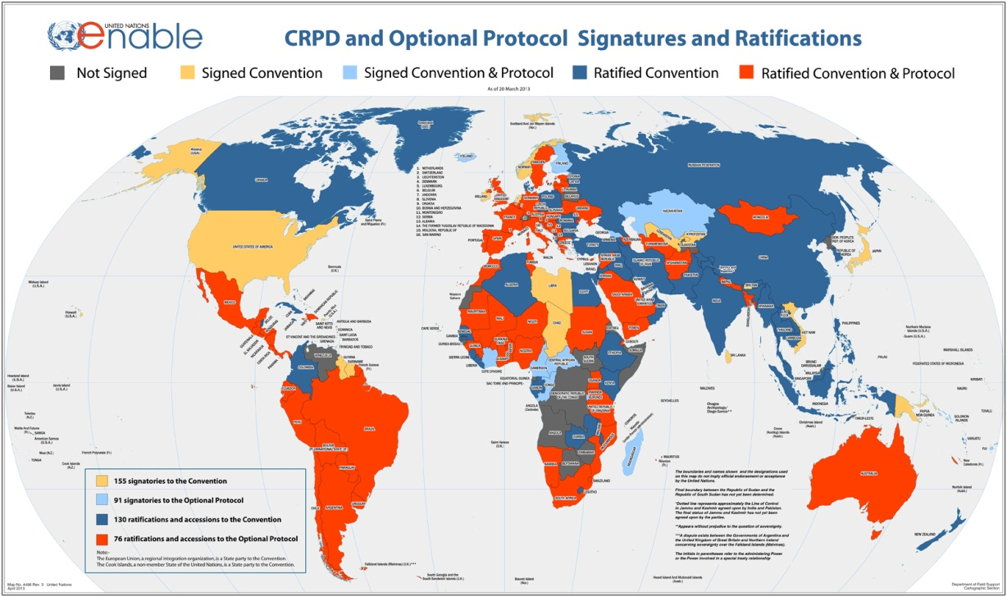

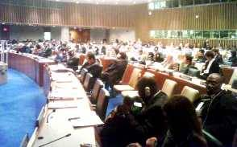
UNITED NATIONS CONVENTION ON THE RIGHTS OF PEOPLE WITH DISABILITIES DEC. 2006:A NEW PARADIGM CENTERED ON THE PERSON WITH DISABILITY
From Medical Model of Disability → Problem in the Person.
Cure, Fix or Separate
To Social Model of Disability based on Human Rights approach- Problem with Society that needs to be changed.
Attitudes
Organisation
Environment
To
158 signatories to the Convention
141 ratifications of the Convention
Optional Protocol
92 signatories
78 ratifications

Slide 41
UNCRPD Article 24 Education
Requires all signatories to ensure all disabled children and young people can fully participate in the state education system and that this should be an ‘inclusive education system at all levels’
The development by persons with disabilities of their personality, talents and creativity, as well as their mental and physical abilities, to their fullest potential.
This right is to be delivered within an inclusive primary and secondary education system, from which disabled people should not be excluded.
Reasonable accommodations should be provided for individual requirements and support provided in individualised programmes to facilitate their effective social and academic education.

Slide 42
UNCRPD Article 24 Education -2
Instruction in Braille , Sign language AAC
Employment of disabled teachers
Train professionals and staff who work at all levels of education. Such training shall incorporate disability awareness and the use of appropriate augmentative and alternative modes, means and formats of communication, educational techniques and materials to support persons with disabilities
Article 8 b-Awareness Raising ‘Fostering at all levels of the education system, including in all children from an early age, an attitude of respect for the rights of persons with disabilities’

Slide 43
UK Government Reservations
"The United Kingdom Government is committed to continuing to develop an inclusive system where parents of disabled children have increasing access to mainstream schools and staff, which have the capacity to meet the needs of disabled children.
The General Education System in the United Kingdom includes mainstream and special schools, which the UK Government understands is allowed under the Convention.
The United Kingdom reserves the right for disabled children to be educated outside their local community where more appropriate education provision is available elsewhere. Nevertheless, parents of disabled children have the same opportunity as other parents to state a preference for the school at which they wish their child to be educated."

Slide 44
New Framework :Children and Families Bill Part 3
New Funding- AWPU, School Funding, Higher Needs Block-over £10,000
Local Offer-include 0-25
New relationship young people & parents
Statement-Education, Health and Care Plan
Includes Academies and Free Schools
Presumption of Inclusion weakened
Relates to disabled children and young people
From September 2014-3 year transition
School Action/School Action Plus-School Stage
New SEN/Disability Code of Practice ( weak on disability)

