Slide 1

Inclusive Education for the 21st Century
Richard Rieser
World of Inclusion Ltd
www.worldofinclusion.com
rlrieser@gmail.com

Slide 2
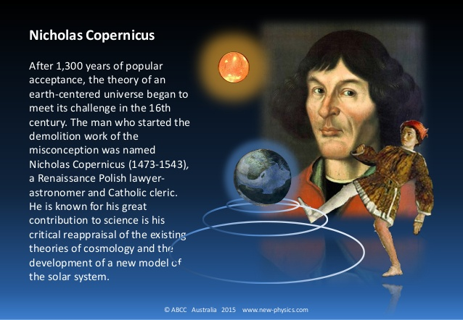
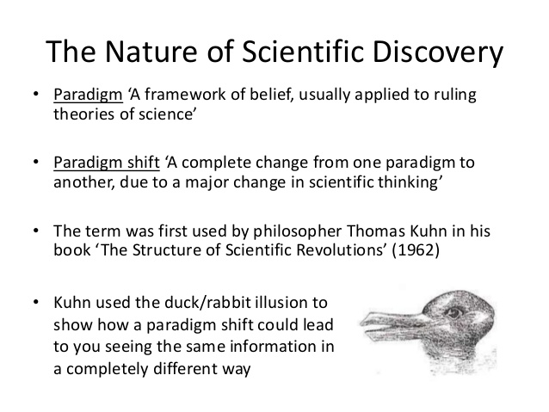
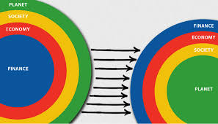

Slide 3
Paradigm Shift at Core of UN Convention on the Rights of Persons with Disabilities (UNCRPD)
“The Convention follows decades of work by the United Nations to change attitudes and approaches to persons with disabilities.
It takes to a new height the movement from viewing persons with disabilities as "objects" of charity, medical treatment and social protection towards viewing persons with disabilities as "subjects" with rights, who are capable of claiming those rights and making decisions for their lives based on their free and informed consent as well as being active members of society”. UN DESA

Slide 4
Bringing about the Paradigm Shift on Disability
1981 Disabled People International first recognised the difference between our impairments and disability.
Impairment is the loss or limitation of physical, mental or sensory function on a long term, or permanent basis.
Disability is the loss or limitation of opportunities to take part in the normal life of the community on an equal level with others due to physical and social barriers.
This definition allowed the Disability Movement to use the ‘social model’ to analyse the oppression people with disabilities face and to campaign for a fundamental change in attitudes and practices as a human rights issue. This analysis led directly to the UNCRPD 25 years later.

Slide 5
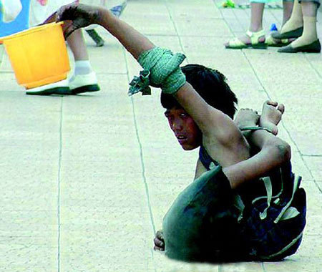
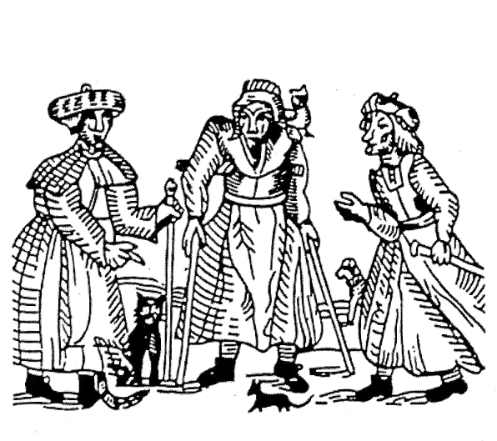
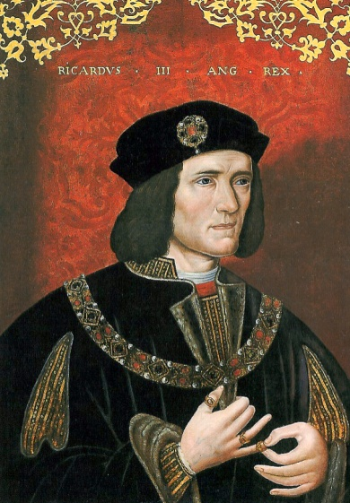
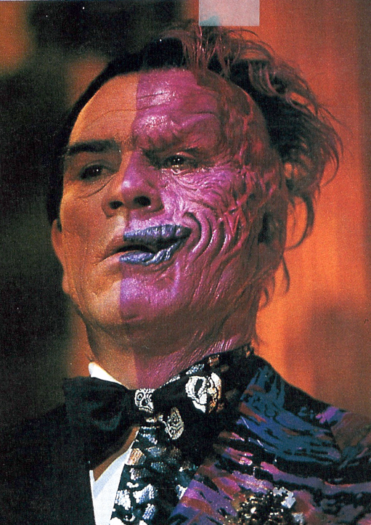
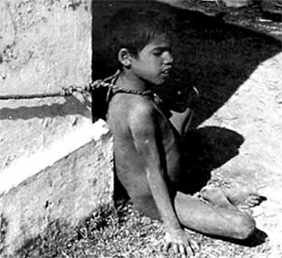
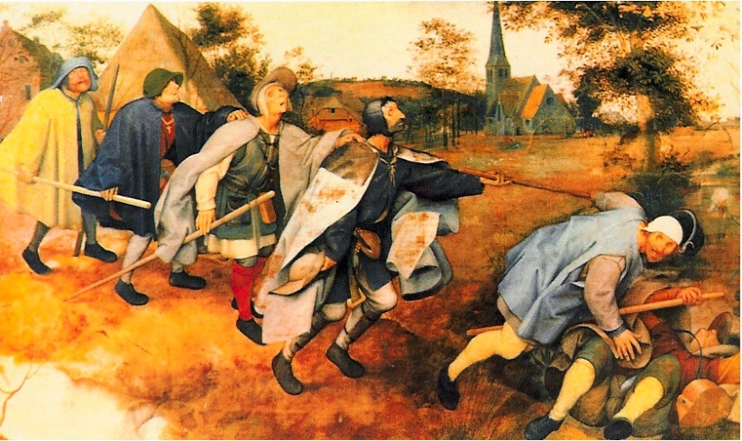
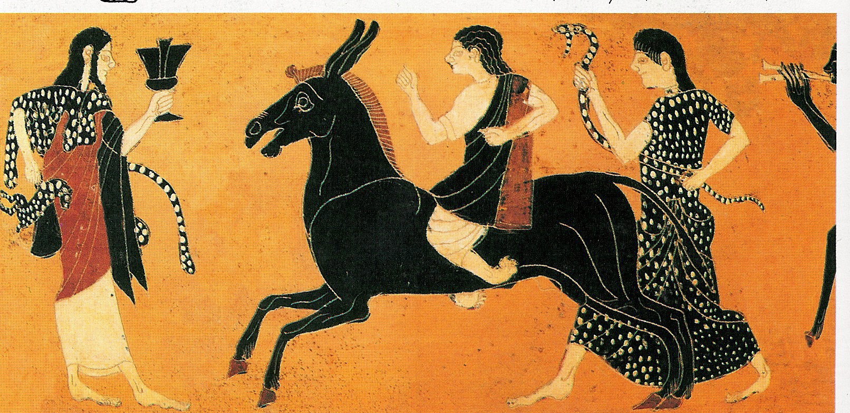
Traditional Models of Disability
For thousands of years people’s lives were ruled by superstition and interpretations of nature, which depended on all powerful deities or Gods. Disabled people were penitent sinners, figures of fun or freaks .
We were often seen as evil or seeking to get our revenge.
These stereotypes persist in literature and the media today.
In East Africa today it is widely believed Albinos have magical powers and their bones are magic.
50% of Indians believed "disability was always or almost always a curse of God." World Bank, 2007

Slide 7
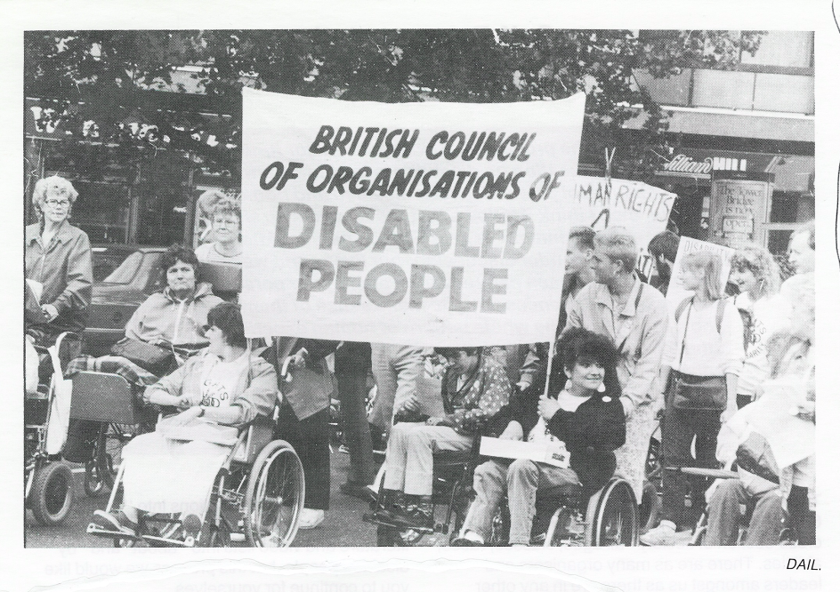
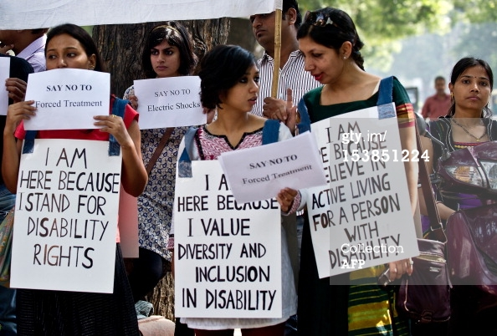
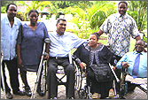
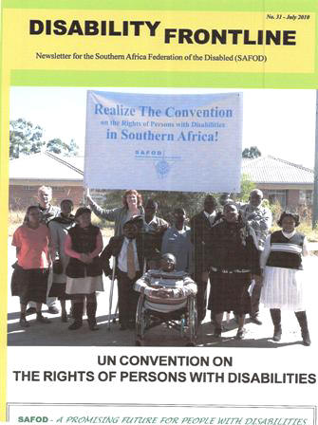
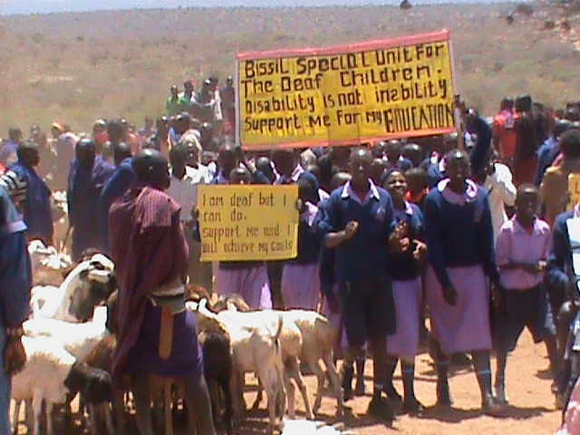
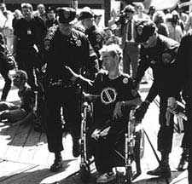
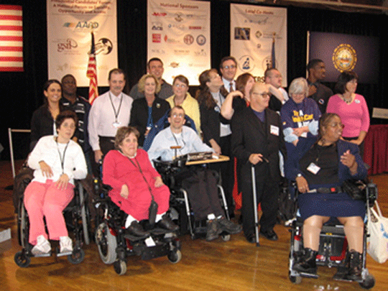
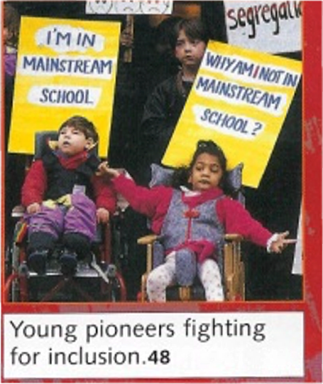
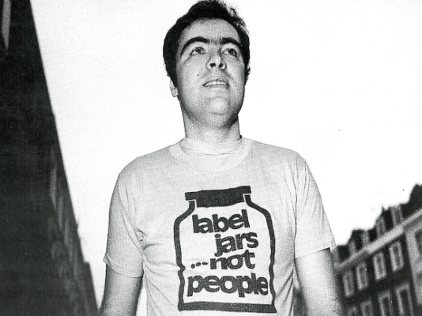
Struggles of Parents and Disabled People for Inclusion
Disabled People & Parents Organise and Fight Back
People First- People with learning Difficulties 1984

Slide 8
Social /Human Rights Model of Disability
Addresses barriers of attitude, environment and organisation

Slide 9
Forms of Organisation of education for children with disabilities

Slide 10

Forms of Geographic Organisation
Move from seeing impairment as determining no school or special school. Schools and teachers who are flexible and where the support is brought to the child.
Develop child centred approach.
Teachers trained in inclusion.
Buildings and learning materials accessible.
Specialist advice and support.
Curriculum flexible.
Peer support.
Community educated for inclusion.
Special schools become resource centres.
Peripatetic specialist teachers

Slide 11
Principles of Inclusive Education
Inclusion is a process it has to be seen as a never-ending search to find better ways of responding to diversity.
• Inclusion is concerned with the identification and removal of barriers.
• Inclusion is about the presence, participation and achievement of all students.
• Inclusion involves a particular emphasis on those groups of learners who may be at risk of marginalisation, exclusion or underachievement..
Mel Ainscow UNESCO ICE 48 Geneva Nov 2008

Slide 12

160
174
92
July 2017

Slide 13

5 Principles SDGs

Slide 16
UNCRPD General Principles Article 3
1.Respect for inherent dignity, individual autonomy including the freedom to make one’s own choices, and independence of persons;
2.Non-discrimination;
3.Full and effective participation and inclusion in society;
4.Respect for difference and acceptance of persons with disabilities as part of human diversity and humanity;
5.Equality of opportunity;
6.Accessibility;
7.Equality between men and women;
8. Respect for the evolving capacities of children with disabilities and respect for the right of children with disabilities to preserve their identities.

Slide 17
UNCRPD Article 24 Education
Requires all signatories to ensure all disabled children and young people can fully participate in the state education system and that this should be an ‘inclusive education system at all levels’
The development by persons with disabilities of their personality, talents and creativity, as well as their mental and physical abilities, to their fullest potential.
This right is to be delivered within an inclusive primary and secondary education system, from which disabled people should not be excluded.
Reasonable accommodations should be provided for individual requirements and support provided in individualised programmes to facilitate their effective social and academic education.

Slide 18
UNCRPD Article 24 Education -2
Instruction in Braille , Sign language AAC
Employment of disabled teachers
Train professionals and staff who work at all levels of education. Such training shall incorporate disability awareness and the use of appropriate augmentative and alternative modes, means and formats of communication, educational techniques and materials to support persons with disabilities
General Comment No 4 Article UNOHCHR Aug 2016
Article 8 b-Awareness Raising ‘Fostering at all levels of the education system, including in all children from an early age, an attitude of respect for the rights of persons with disabilities’

Slide 19
Track Two
Education accommodating
the different impairment specific needs of
children with disabilities.
Speech & Communication
Facilitated Communication,
Augmented Communication,
Switching,
Talkers,
Information Grids.
Blind And Visually Impaired
Braille, Tactile Maps
Tapes and Text to Talk,
Mobility Training,
Large Print, Magnification,
Orientation,
Auditory Environment &
Talking instruments
Mental Health and Behaviour
Counselling and
Personal support,
Differentiated
Behaviour Policy, Empathy
Quiet /chill out space,
Circle of Friends,
Differentiated Behaviour Policy, Structured Day.
Deaf & Hearing Impaired
Sign Language Taught &
Interpretation,
Oral/Finger Spelling,
Hearing Aid Support,
Visual Environments
Physical Impairment
Accessible Infra-structure.
Toilets, Furniture
Equipment, prosthesis,
Personal Assistance
Diet, Transport,
Medication.
Specific Learning Difficulty
Colour overlays & background
Easy Read
Tapes and Text to Talk
Spell- checker
Concrete objects
Screening, identification and key adjustments for main impairments
General Cognitive Impairment
Pictograms, Small Steps Curriculum, Easy Read, Scaffolding, Makaton, Symbols, Info. Grids,
Concrete objects
Deaf Blind Language,
Interpreters,
Tactile Environment,
Orientation
Foundations
Identifying Barriers-Finding Solutions
Equality and Valuing Difference
Collaborative Learning
Peer Support
Track One
Education based on Principles of
Equality and Child
Empowerment.
Differentiation & Flexible Curriculum and Assessment
Anti Bias Curriculum
Stimulating and Interesting Multi-Sensory Learning Environment
Child Centred Pedagogy, Creative with Reflective Teachers
Quality education requiring rigour and effort for each child to achieve their potential
Training for Inclusive Education Twin Track Approach

Slide 20

Training routes and options for teachers’ professional development for inclusion of children with disabilities.
In-service /Continuing Professional Development- twin track.
Whole school staff training all teaching staff
Withdrawal for selected teachers to cascade to colleagues
Individual teachers undertake further award bearing study leading to Diploma, B.Ed or Masters in Inclusive Education
School based/district training with external tutor leading to additional qualification.
All need monitoring and follow up on implementation.
Leadership Training for Inclusion
Principals/headteachers and local administrators need to have training on both tracks
Training on best ways of managing and delivering training of colleagues.
Resource teachers trained in both tracks with specialism in one or more impairment specific area.
To work across a district from a local resource centre providing on going mentoring, support and monitoring
Initial or Pre-Service-twin track
College based-2 or 3 years.
Lecturers need knowledge, skills and understanding including children with disabilities
Students need practicum in schools with good practice
School based
Need school based mentors
Distance learning using ICT,TV,DVD,Radio
Study leave and taught courses
Teachers need decent salaries and conditions, incentives to complete additional training for inclusion and for deployment to hard to reach areas.
Quality needs monitoring.

Slide 21
In the Social Model It's the barriers that disable !
Negative
Attitudes
Inaccesible
Environments
Bullying
Use of Resources
Poor Support
Inflexible Curriculum
Lack of Communication
Lack of Role Models
Ignorance
Poor Teaching
Fear
Low Expectations

Slide 23
Four key questions to help develop inclusive practice in lesson preparation.
1. As you are planning any lesson for pupils ask yourself what are the essential knowledge, skills or understanding you want all students to get from the lesson?
2. How do my pupils learn best? Take account of learning styles. Most pupils can learn in visual, auditory or kinaesthetic ways, though most have a preference and it is good to know these.
3. What modifications to the lesson plan would permit more pupils to learn more effectively in my classroom? All teachers are very used to modifying their lessons to enhance their pupils learning, e.g. Scaffolding
4. How will my pupils show what they have learned? Ask the pupils to respond in ways they can handle. Assess pupils through their strengths not their weaknesses.
Gary Bunch How to Book of Inclusion
Notes:
For the inclusive classroom what is essential and how do you make sure all pupils have learned it at their own level.

Slide 24
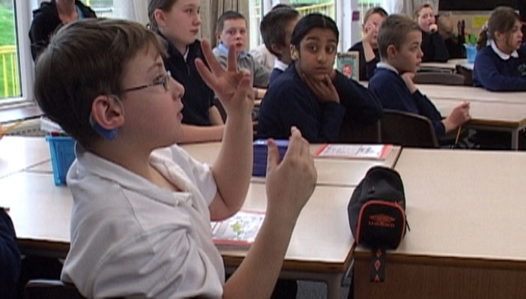
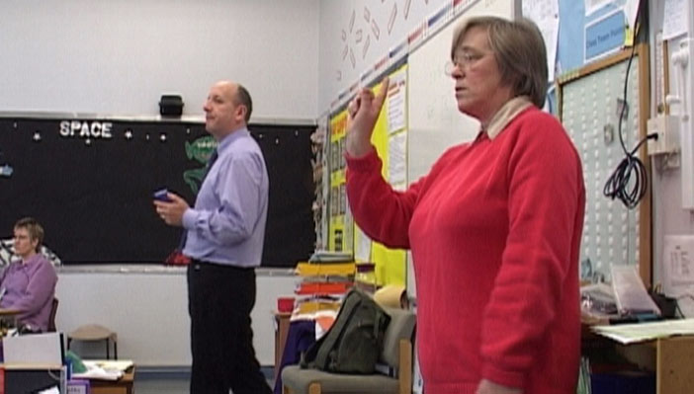
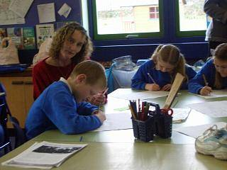
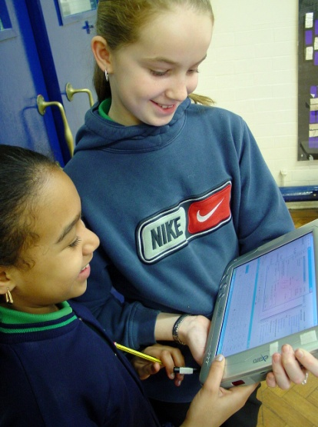
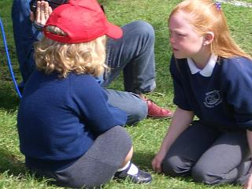
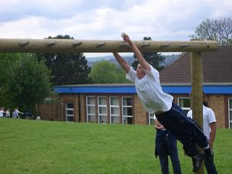
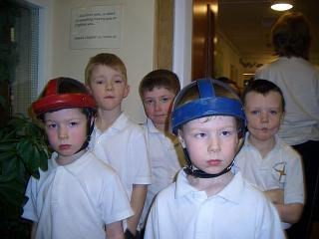
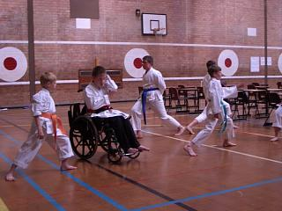
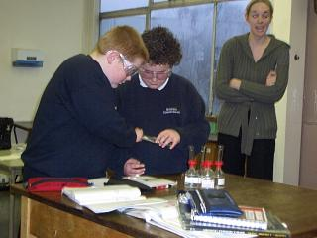
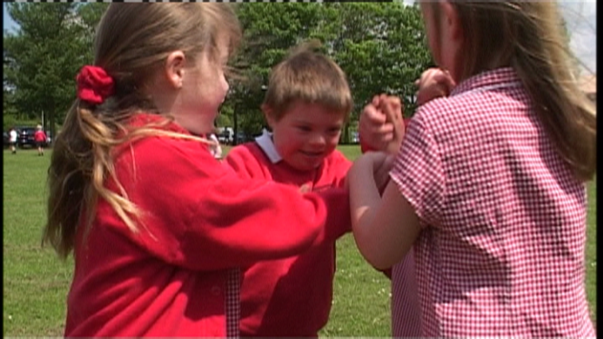
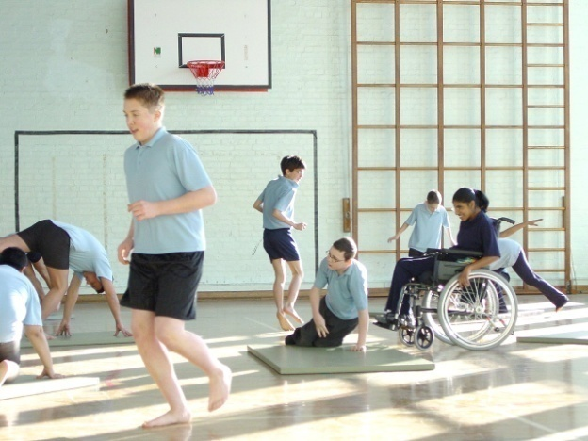
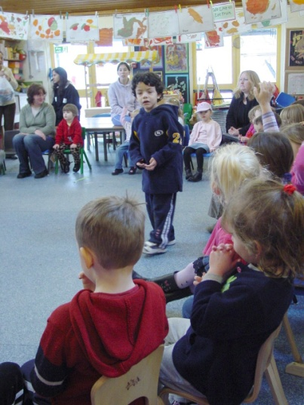
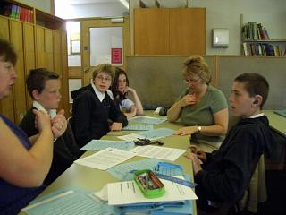
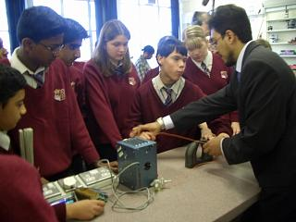
High Income Country
Reasonable Accommodations

Slide 25
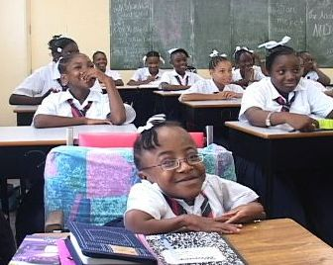
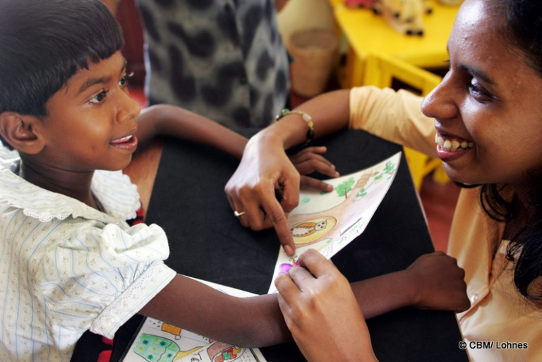
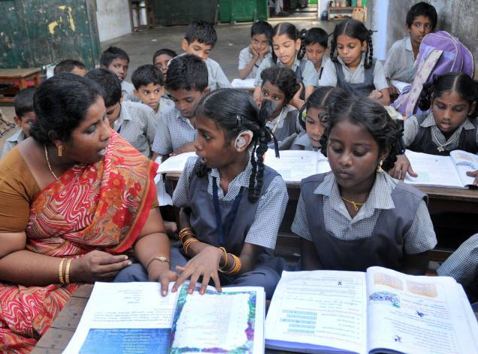
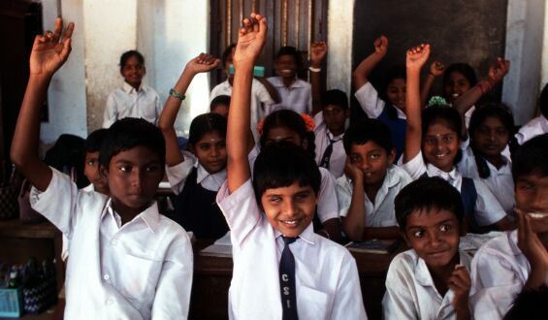
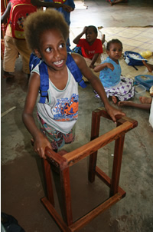
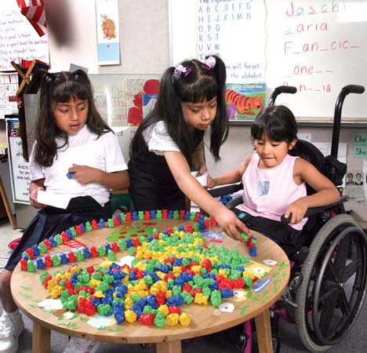
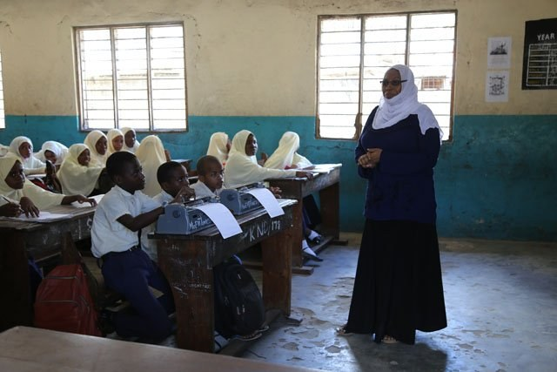
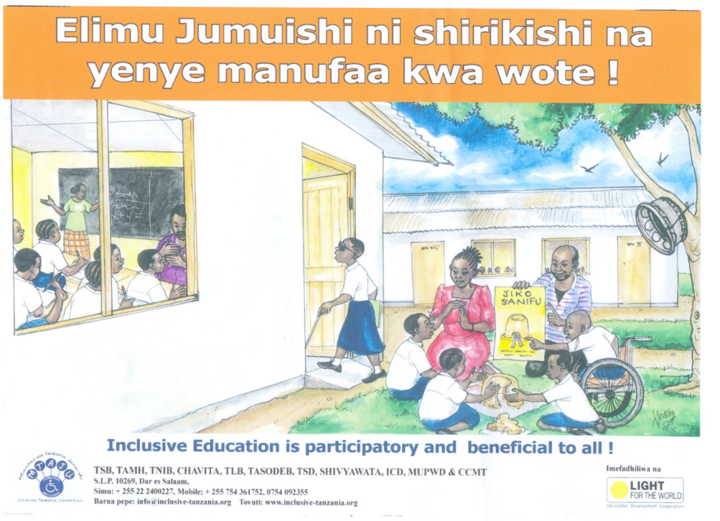
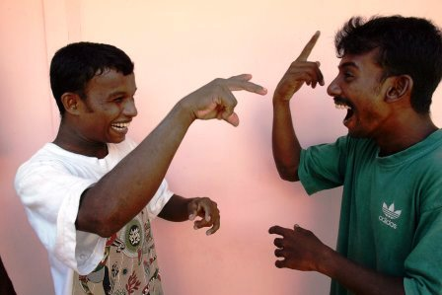
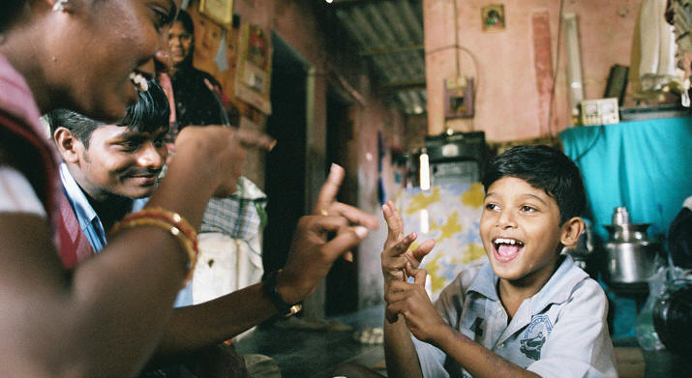
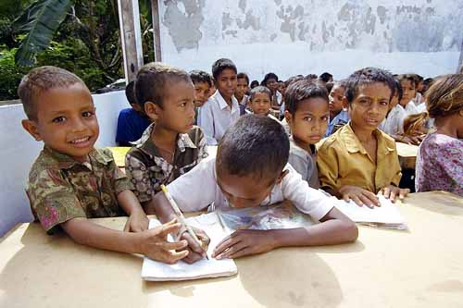
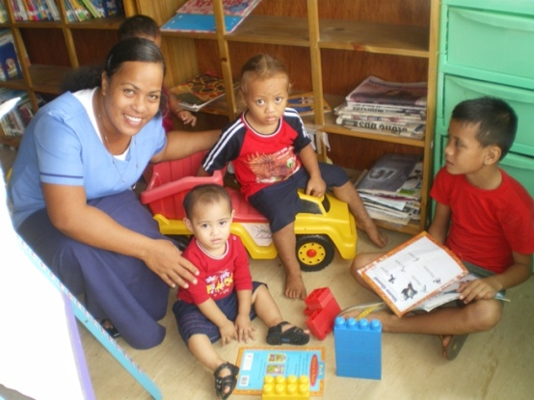
Reasonable Accommodation in Low and Middle Income Countries (LMICs)

Slide 26
Towards a Person Centred Approach
‘When we attend very much to the techniques for delivering curriculum, we need to keep remembering that teaching is first and foremost a matter of the development of human beings as moral actors, as citizens, as people who are going to live in, and need to make a difference to, a diverse and complex world. That requires far more than simply the delivery of instruction as marked by test results.
It's a matter of the heart, as marked by the kind of relationships and the sense of community that develops over time in a school.'
(John O'Brien).

Slide 28
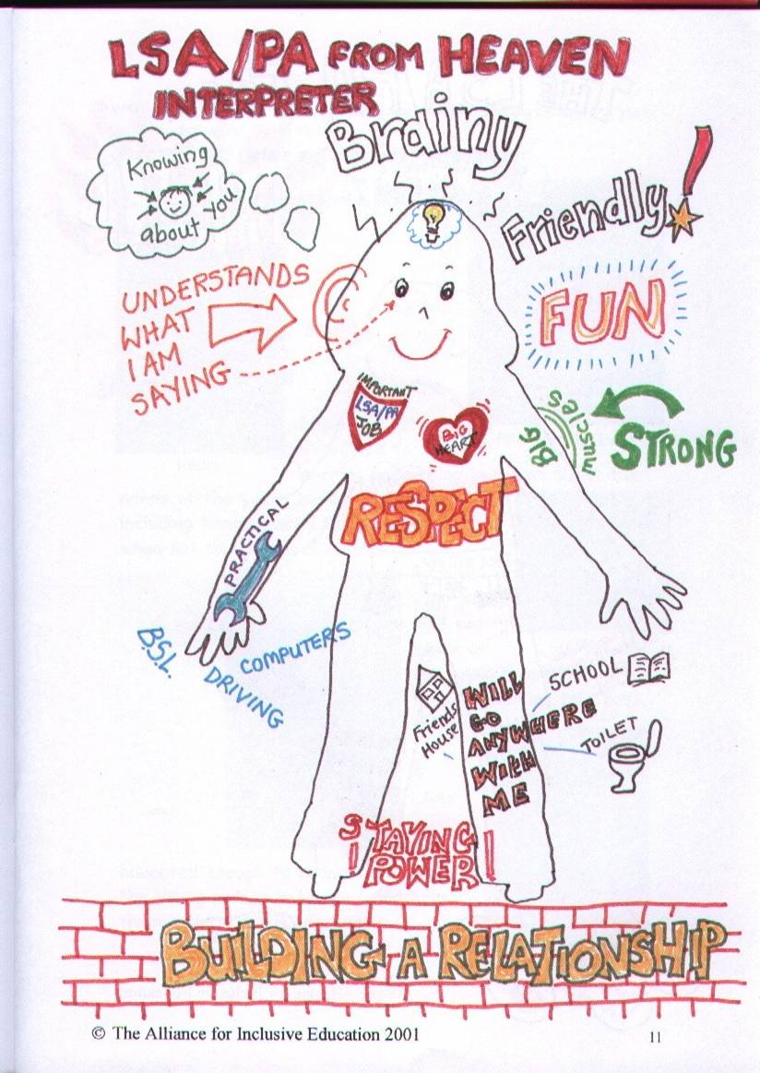
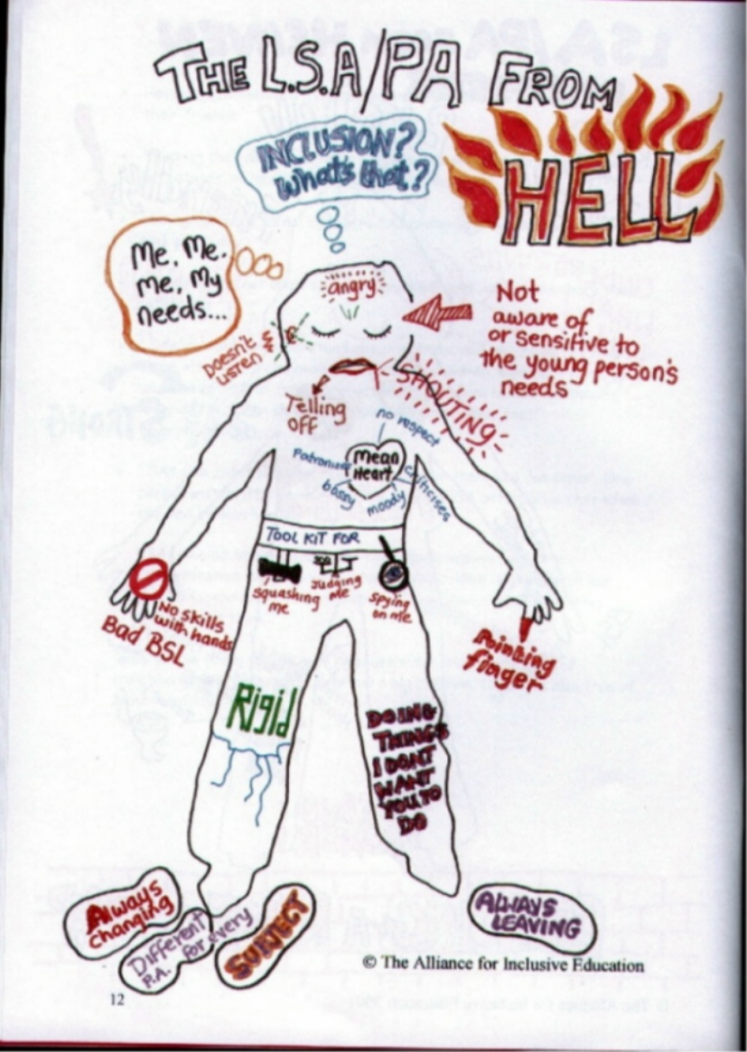

Getting Support Right
Notes:
14 young people who between them had had more than 100 teaching assistants

Slide 29
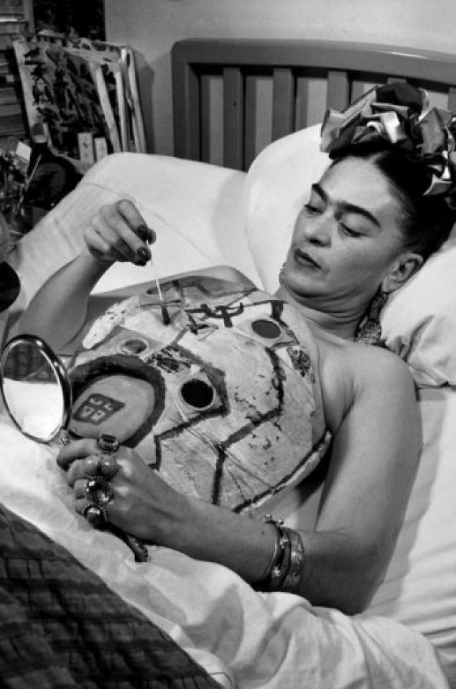
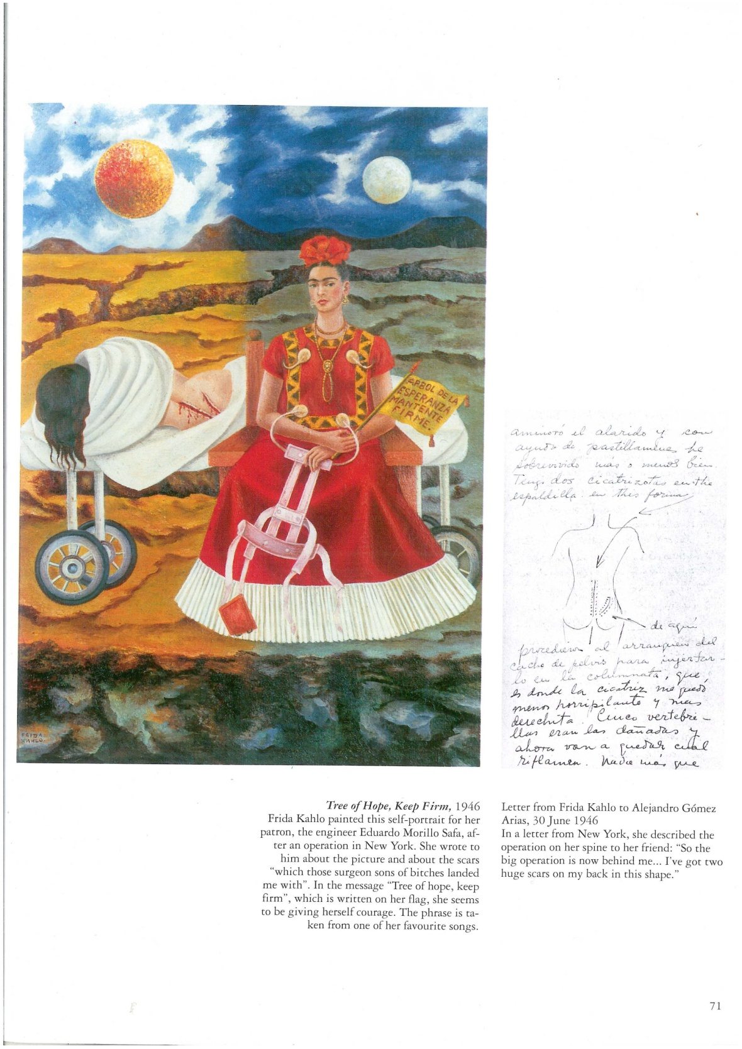
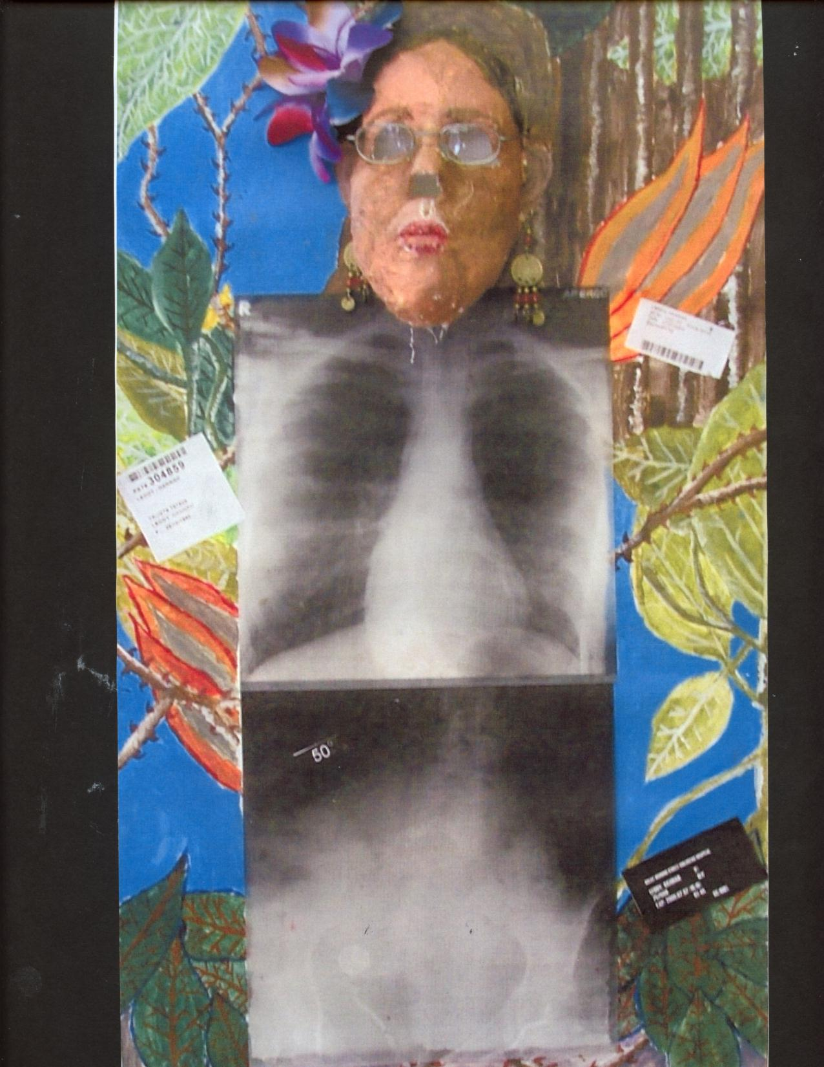
Disability and the Art of Frida Kahlo
Frida had polio as a child. At 18 years, a crash left her with spinal and pelvic impairments
A disabled student draws inspiration from Frida Kahlo
Tree of Hope Keep Firm 1946

Slide 30

















Bring Disability Equality into the Curriculum for all Learners

Slide 31














Sudha Chandran
Winston Churchill
F.D.Roosevelt
Ravindra Jain
Lee Thiam Wah
Malathi Holla
Dr Ismail Salleh
Sadhna Dhand
Peter Drinklage
Game of Thrones
John Milton
Arurima Sinha
Pablo Pineda
Lenin
Moreno
Zuly Sanguino

Slide 32



Dhravi, Mumbai, India
Angawadis to School
Now SSA across the whole country
2010 All disabled children a right to education

Slide 33

Schools as Centres of Care and Support (SCCS) KwaZulu Natal
The SCCS has been used and tested, both within and beyond South Africa, as a model of mainstream care and support in education. The following key principles have contributed to the model’s success and replicability:
•The school supports communities to respond to poverty, HIV & AIDS, conflict and gender-related issues.
•Meaningful participation by children, youth, the school and its community.
•Culturally and contextually appropriate approaches.
•Existing structures and initiatives are built on.
• A multi-sectoral partnership approach.
Integrated into government plans and budgets.
After successful pilot in Uglo district. All KZN and 5 other SADC countries now operate. MIET

Slide 34

Itinerant teachers for Blind and Visually Impaired
Programmes have been established in low- and middle income countries including Kenya, Uganda, Malawi, Bangladesh and India
Itinerant teachers travel to mainstream schools to provide individual tutoring in reading and writing Braille (using a frame and stylus) for blind children and those with severe low vision.

Slide 35



Mata Escura, Brazil
By 2011 Brazil had established 30,000 resource bases in schools to support the learning of disabled children.
They have Braille facilities, Sign Language, Augmented and Facilitated Communication & Learning materials
2015 Legislation aligned with CRPD.
With 15% of population being people with disabilities, only 3% of those enrolled in early primary grades are children with disabilities (CWD).

Slide 36
The evidence for the efficacy of Inclusive Education is Clear
Where there is a choice of special, segregated schools and mainstream, CWD do considerably better when matched for impairment type and degree in mainstream schools academically.
Their inclusion has a neutral impact on children without disabilities and in a quarter of studies has a positive impact on their learning.
Where it has a positive impact, their teachers have been trained in inclusive pedagogy and have inclusive values.
The more flexible the learning and assessment approach the better the learners with disabilities do.
Those young people with disabilities who have attended mainstream school and completed are much more likely to get a job, have friends and relationships than those who went to special schools or units or did not attend school. http://alana.org.br/wp-content/uploads/2016/12/A_Summary_of_the_evidence_on_inclusive_education.pdf
Braziian Research Org.

Slide 37


Slide 38
Local Inclusion Initiatives Must be Brought to National Scale
All Governments must adopt a 10 year plan to develop Inclusive Education for All children:
Ring fence funding for Access program, Reasonable Accommodations and Support
Involve all children/ students, disabled and non-disabled, to receive Disability Equality and Anti Bullying Training
Challenge complacency , reaction and corruption
Every local area needs an inclusion resource centre
Funding must be locally controlled and globally provided
A bottom up movement
Special Needs and the Medical Model Paradigm to be challenged at all levels and replaced by Inclusive Pedagogy
Twin Track approach
High tech and low tech solutions
All teachers must receive Disability Equality and Inclusion training, in-service and pre-service.
To develop inclusion we need a democratic inclusive movement.
Will be of benefit to all and to society in developing the SDGs!

Slide 39

Which way for the world?
People or Profits!
Competition or Collaboration
Developing Disability Equality & Inclusion will make a lasting shift to people’s equality and human rights.
Challenges to inclusion
New Rigid and irrelevant curriculum and high stakes testing
Neo-liberalism and marketisation
Creating a two tier education system - Academies and free schools
Hobbling of Local Municipalities or Excessive Centralisation
Political interference-failure to involve teachers in developing the education system
Growing social and economic inequality
Reductions in public spending
Hate and scape-goating

Slide 40

"EDUCATION is the most POWERFUL weapon which you can use to CHANGE the WORLD"
All Means All
We must build a powerful grass roots Global Campaign for inclusive education- of Parents, Young People, Young Disabled People, DPOs, Teachers and Governments, Disabled Adults and NGOs, UNICEF,UNESCO, World Bank, UNDESA.
All Means All

